Slide 1
Hadoop Distributed File System (HDFS)
By AltoTech

Slide 2
Why Move Away from Relational Database

Slide 3
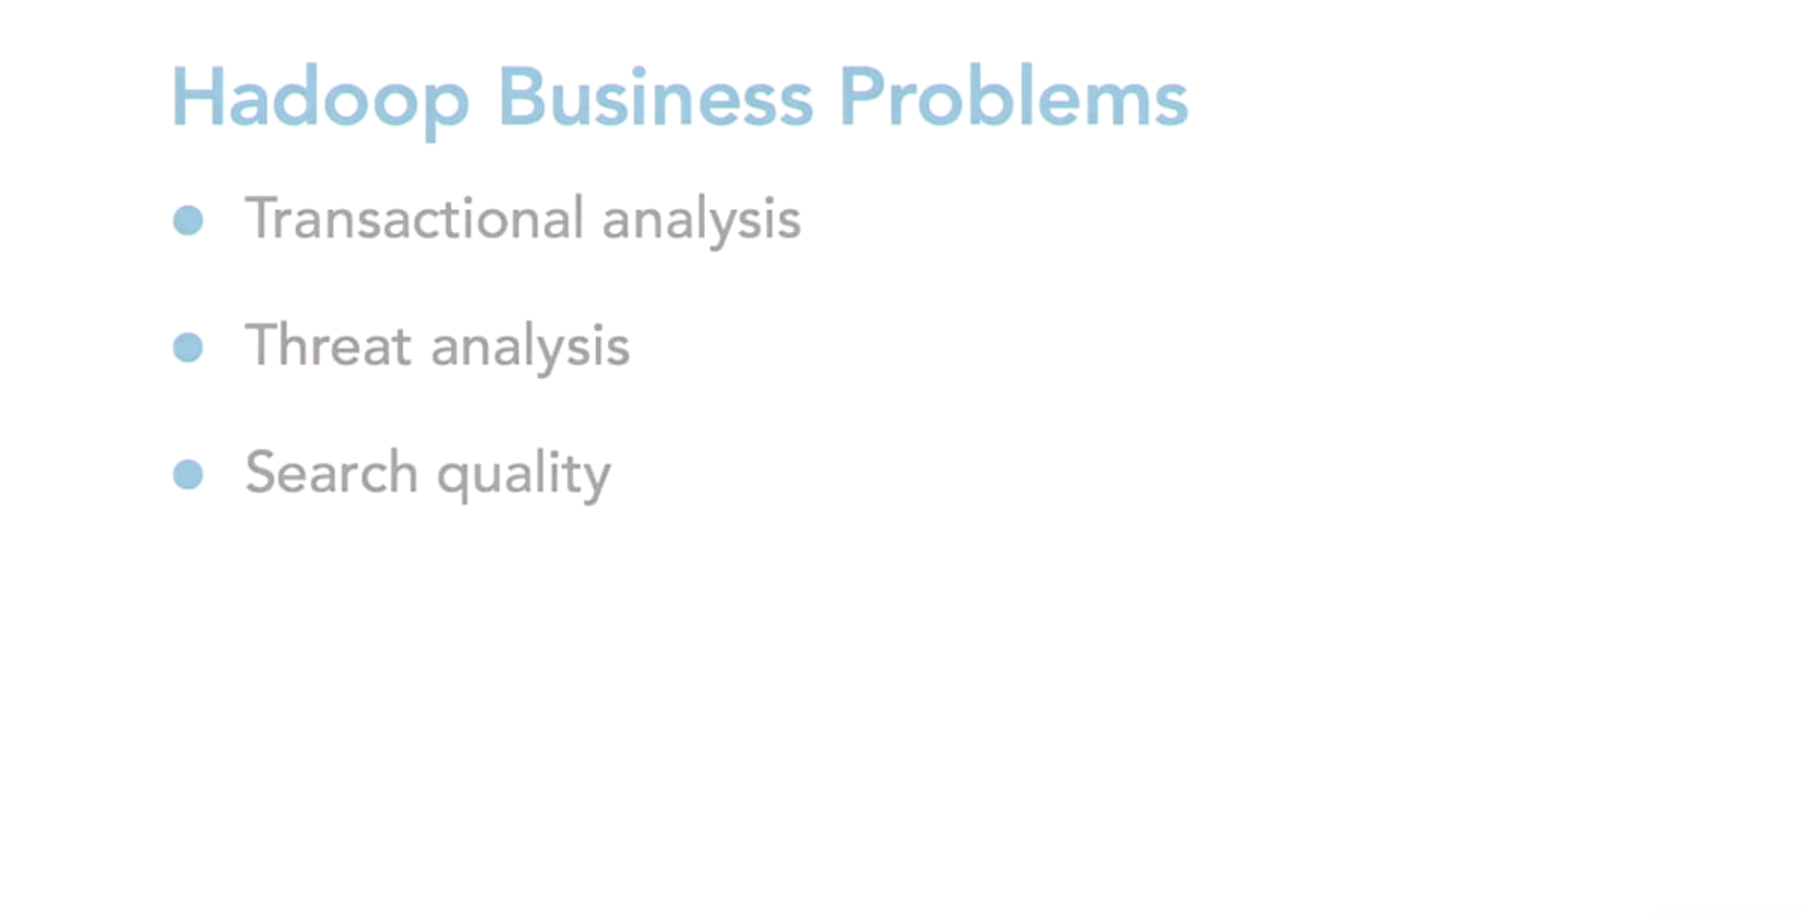
Why Move Away from Relational Database

Slide 4
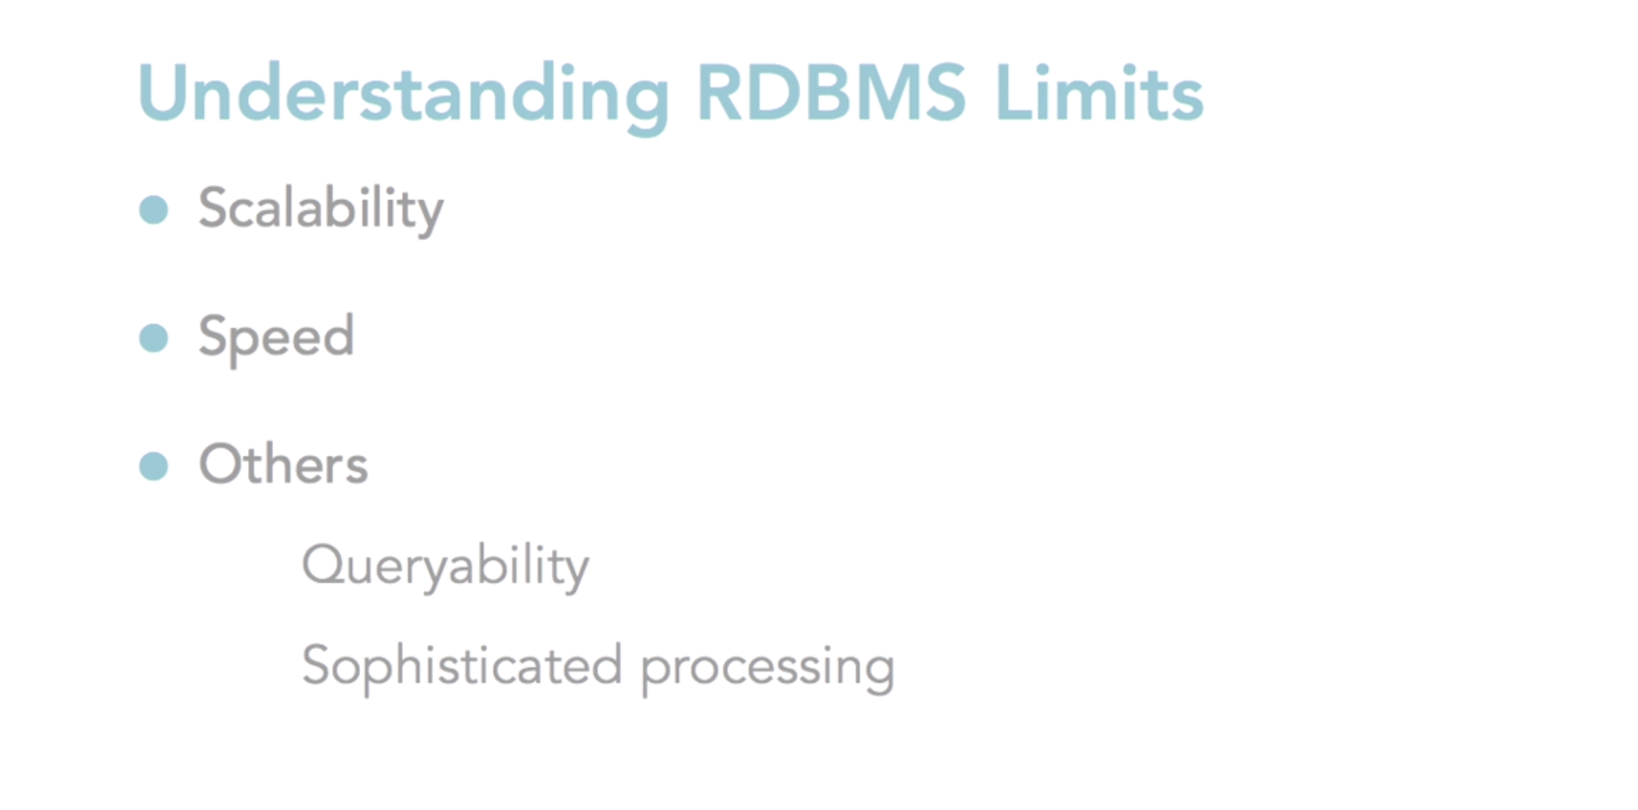
Why Move Away from Relational Database

Slide 5
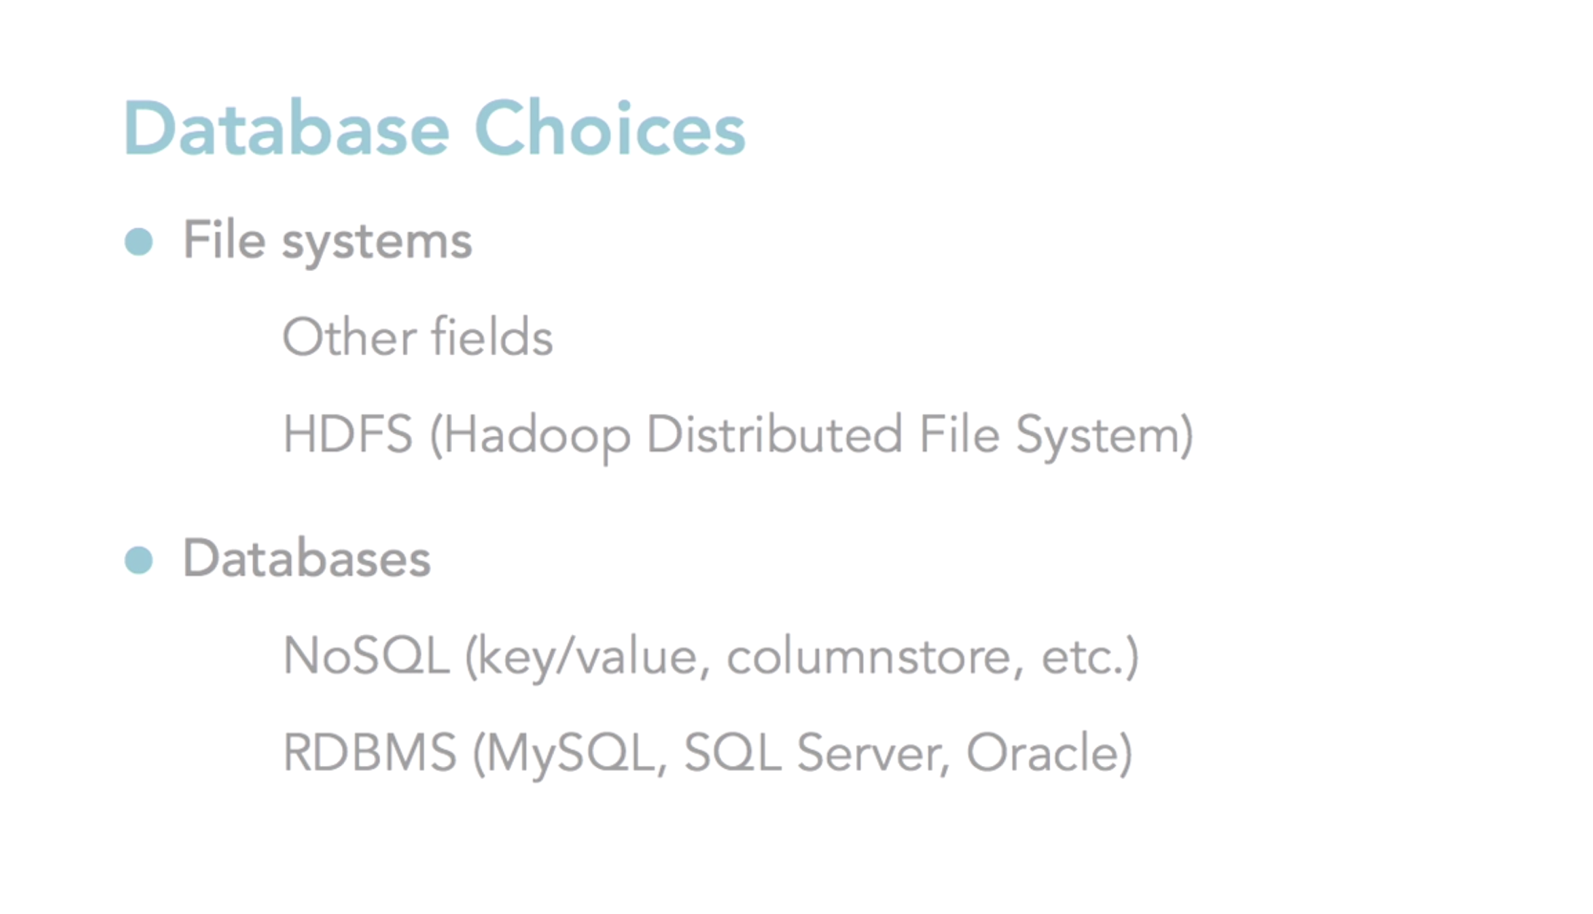
Why Move Away from Relational Database

Slide 6
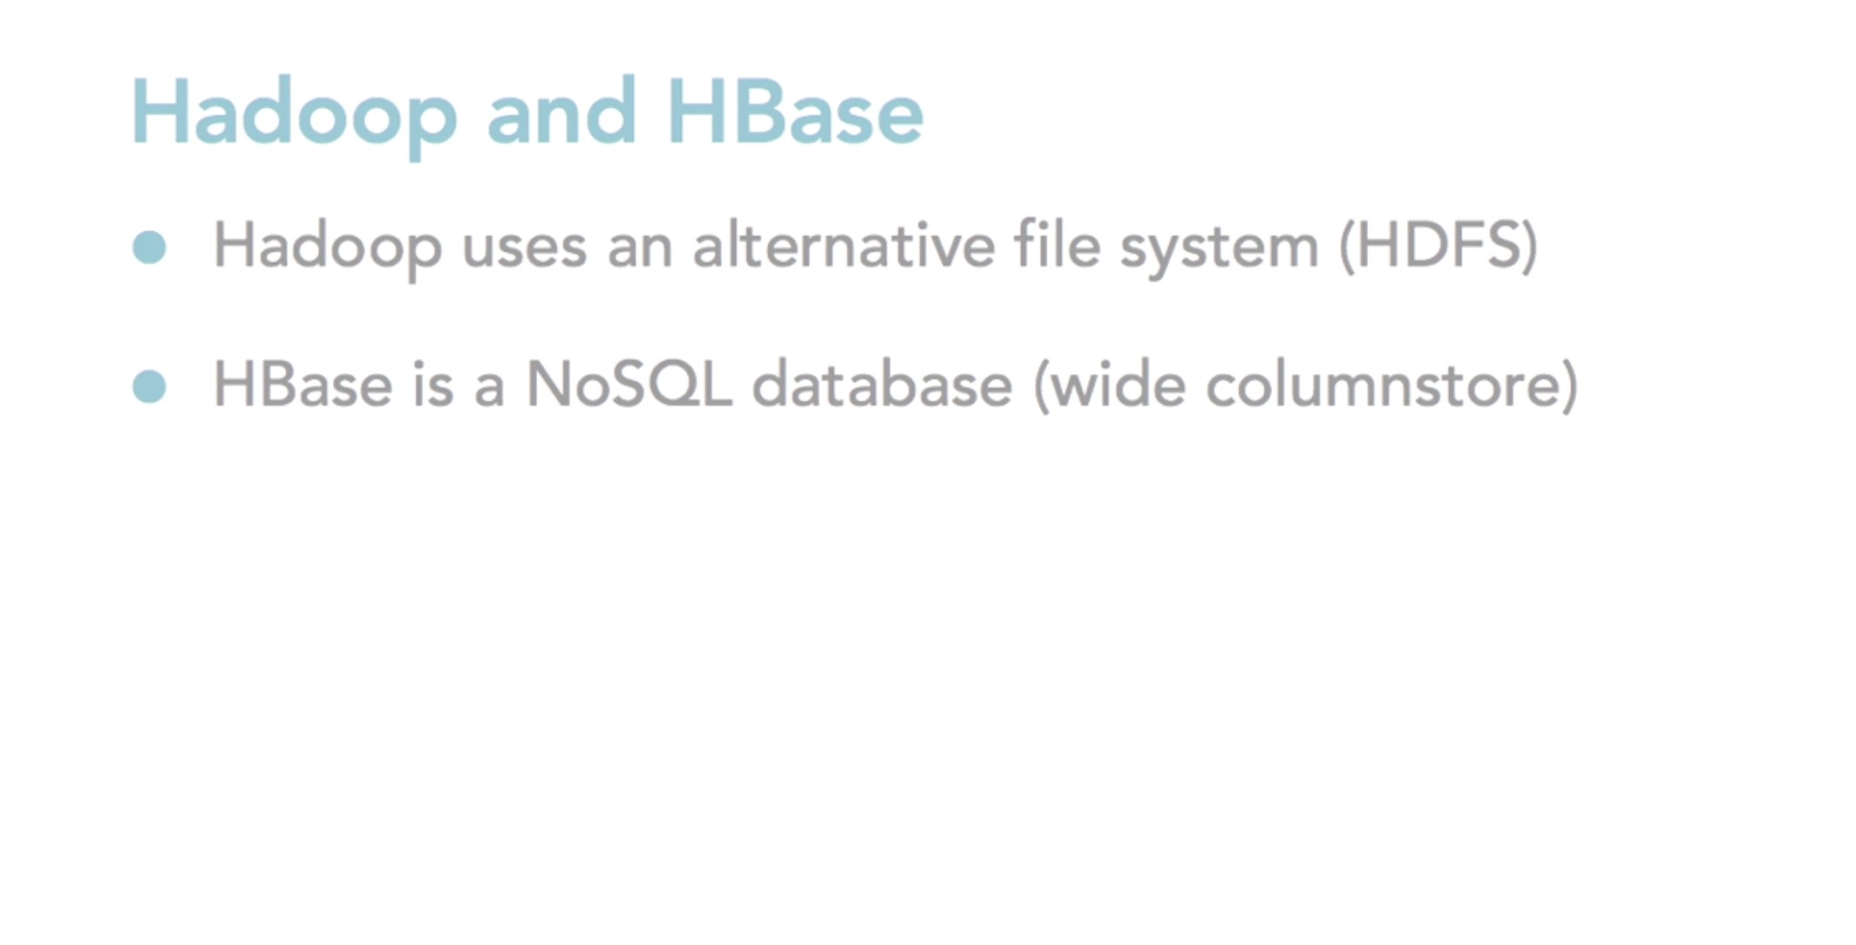
Why Move Away from Relational Database

Slide 7
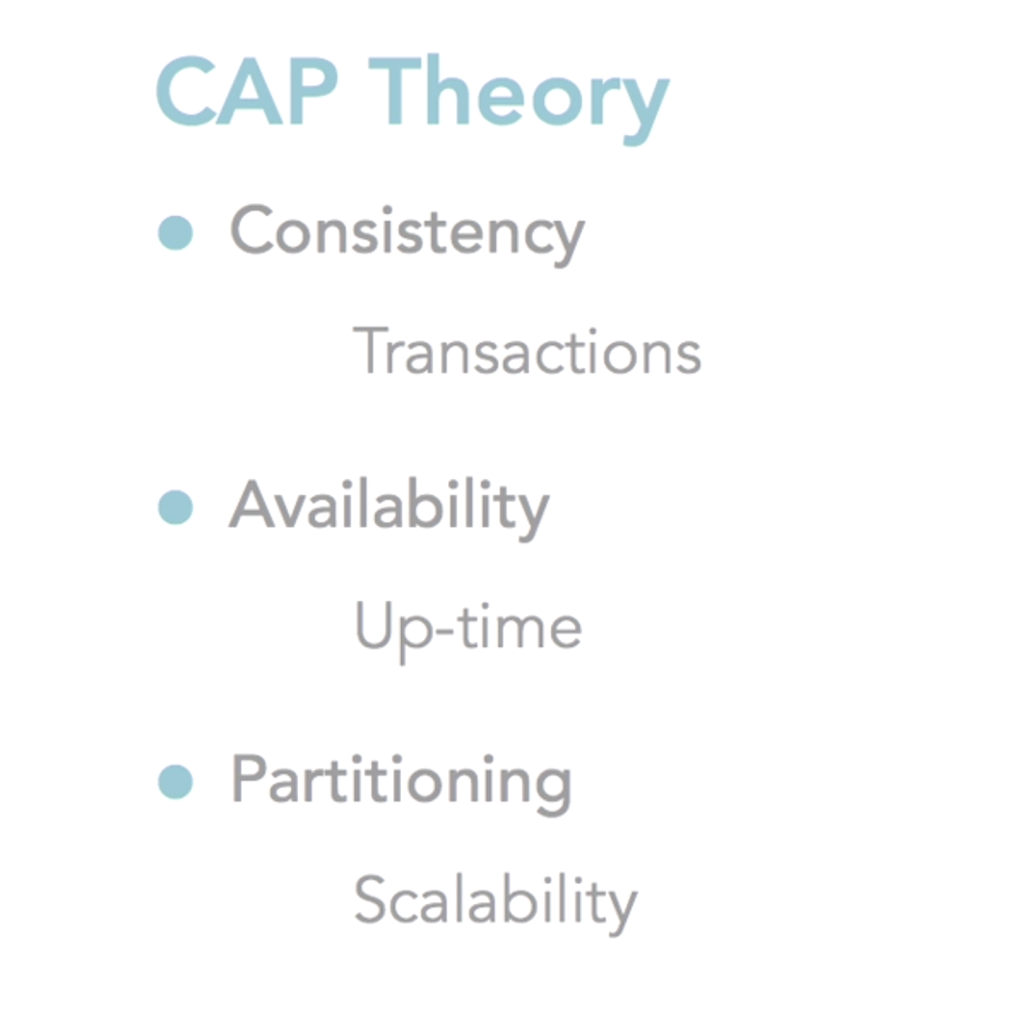
Why Move Away from Relational Database
Relational Database struggles with the high level of partitioning
As company data is growing larger and larger, partitioning and complexities are casing companies to looking at other solutions rather than Relational Database

Slide 8
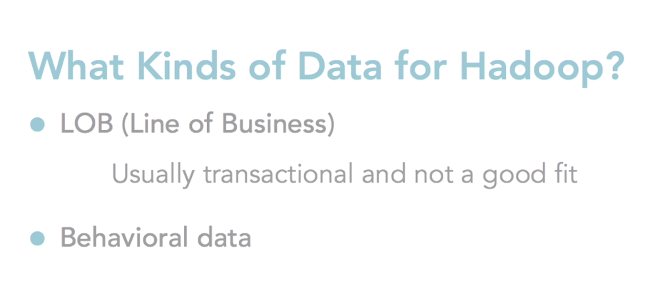
Why Move Away from Relational Database
E.g. Fitbit data

Slide 9
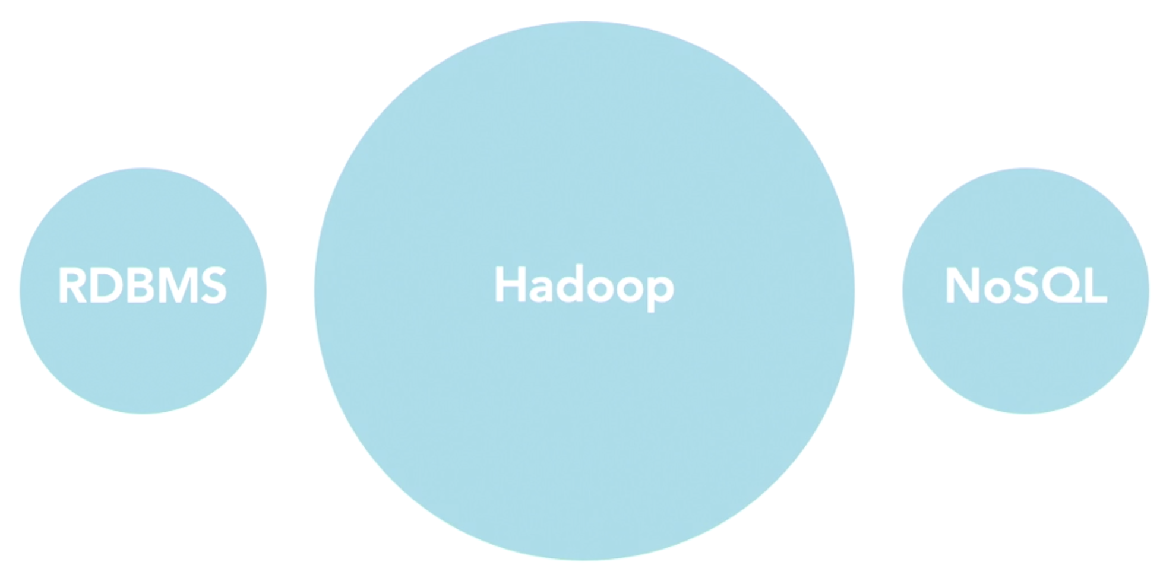
Why Move Away from Relational Database
2. Looks at volume of dat we collecting (e.g. e-learning recording all activities of students)
3. Provide abstraction layer on top of Hadoop, so you can get usable information out of big circle
1. Think about optimization we want to do
(good for batch data processing)

Slide 10
2. What is Hadoop

Slide 11
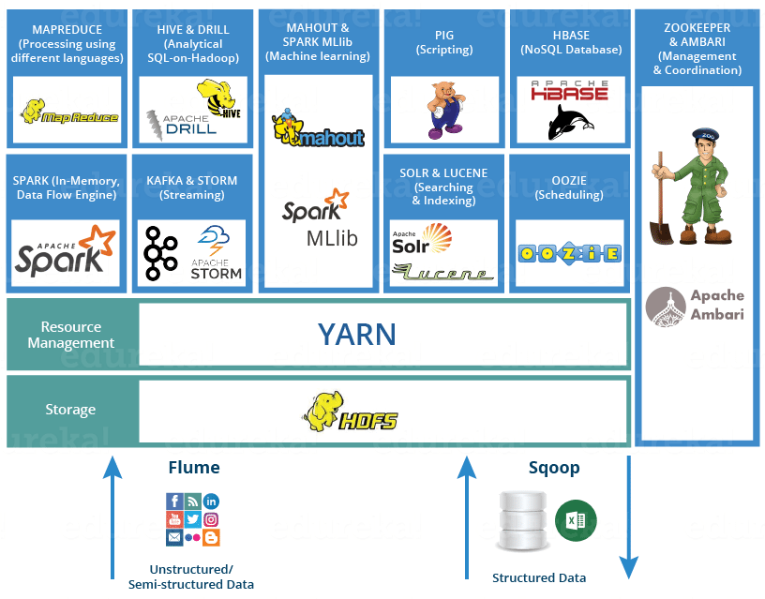
What is Hadoop? - Hadoop vs HBase

Slide 12
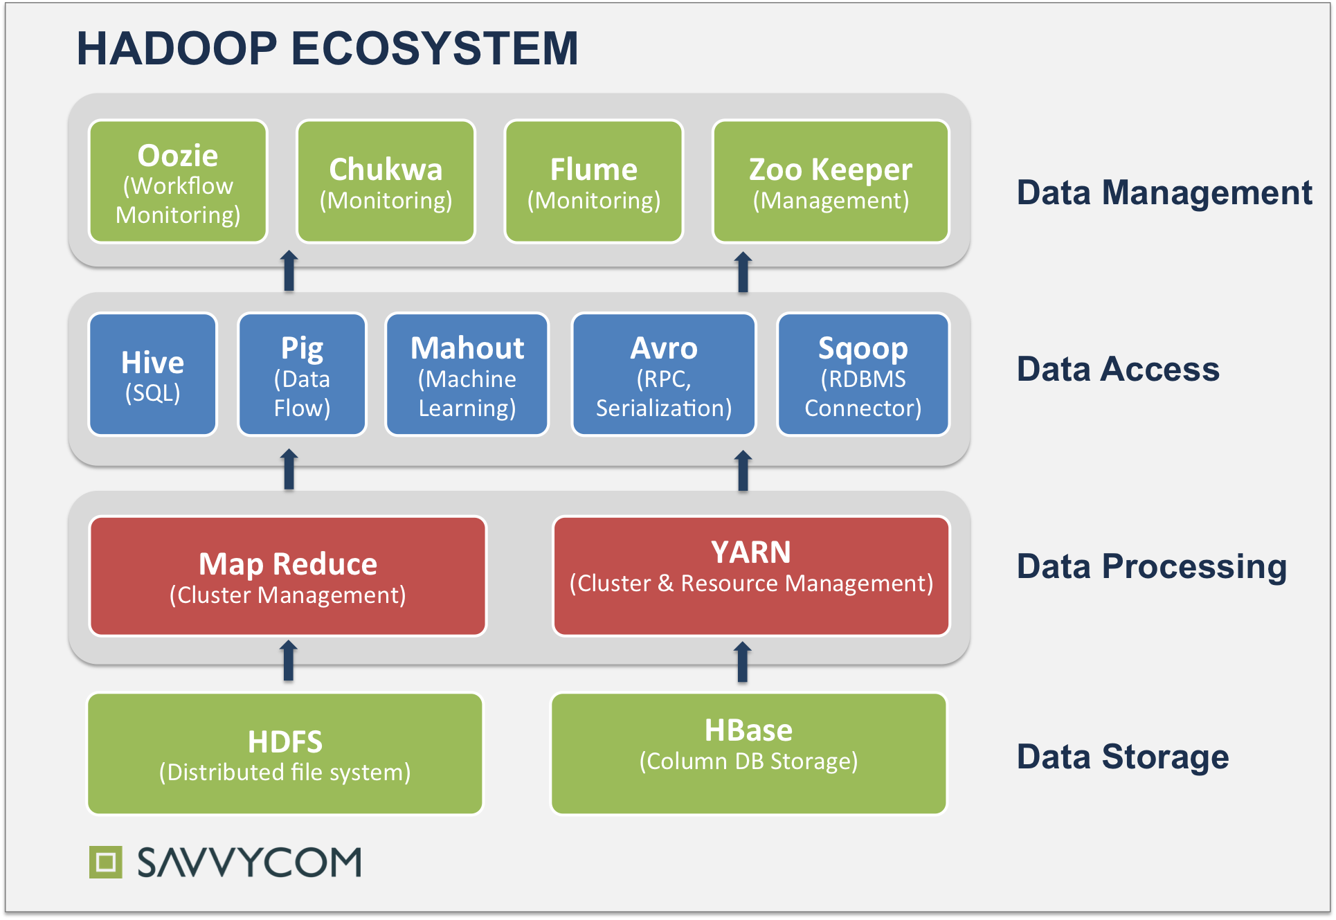
What is Hadoop? - Hadoop vs HBase

Slide 13
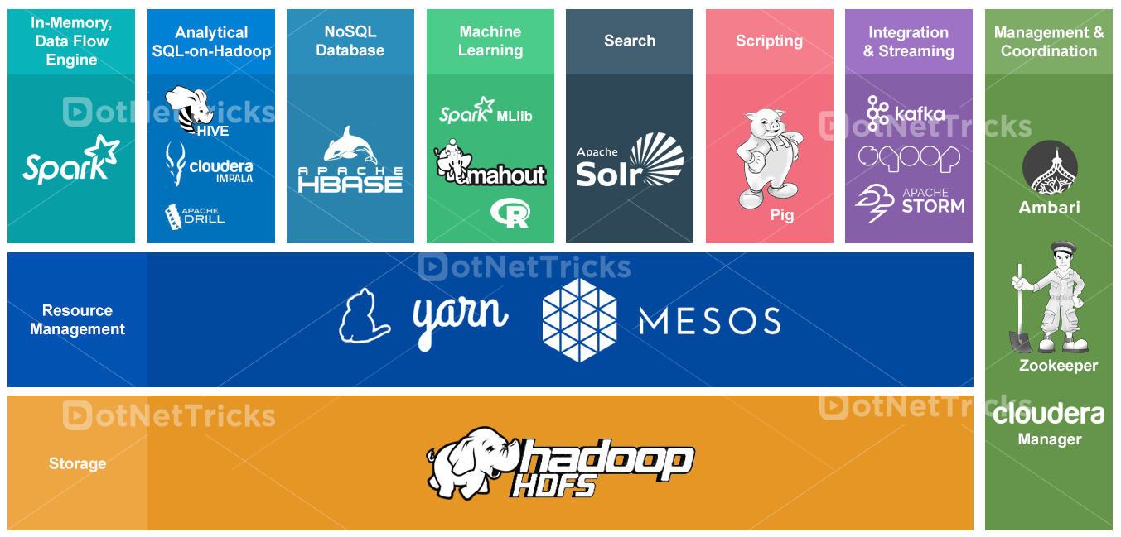
What is Hadoop? - Hadoop vs HBase

Slide 14
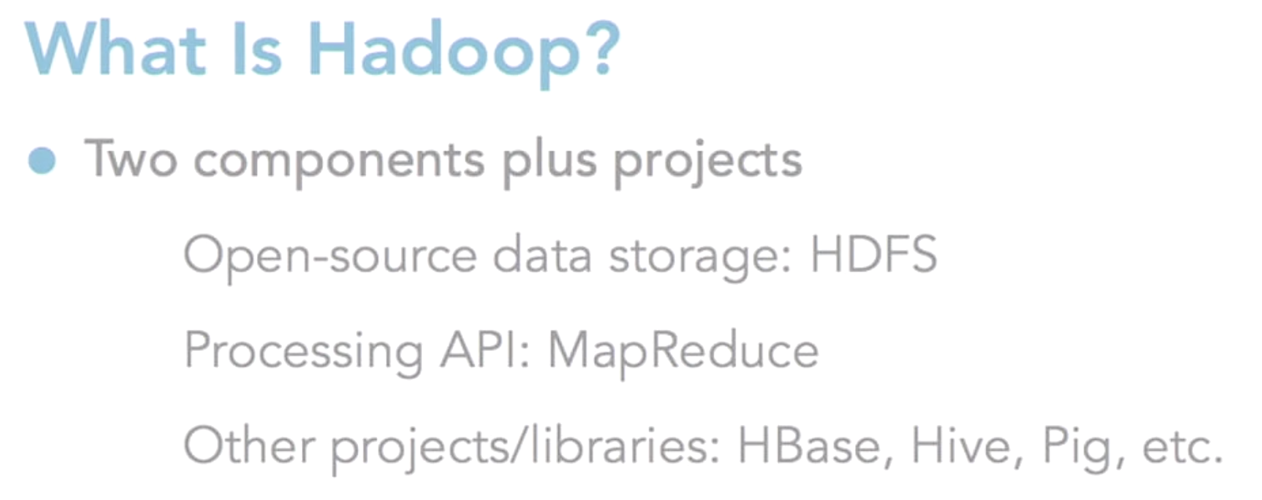
What is Hadoop?

Slide 15
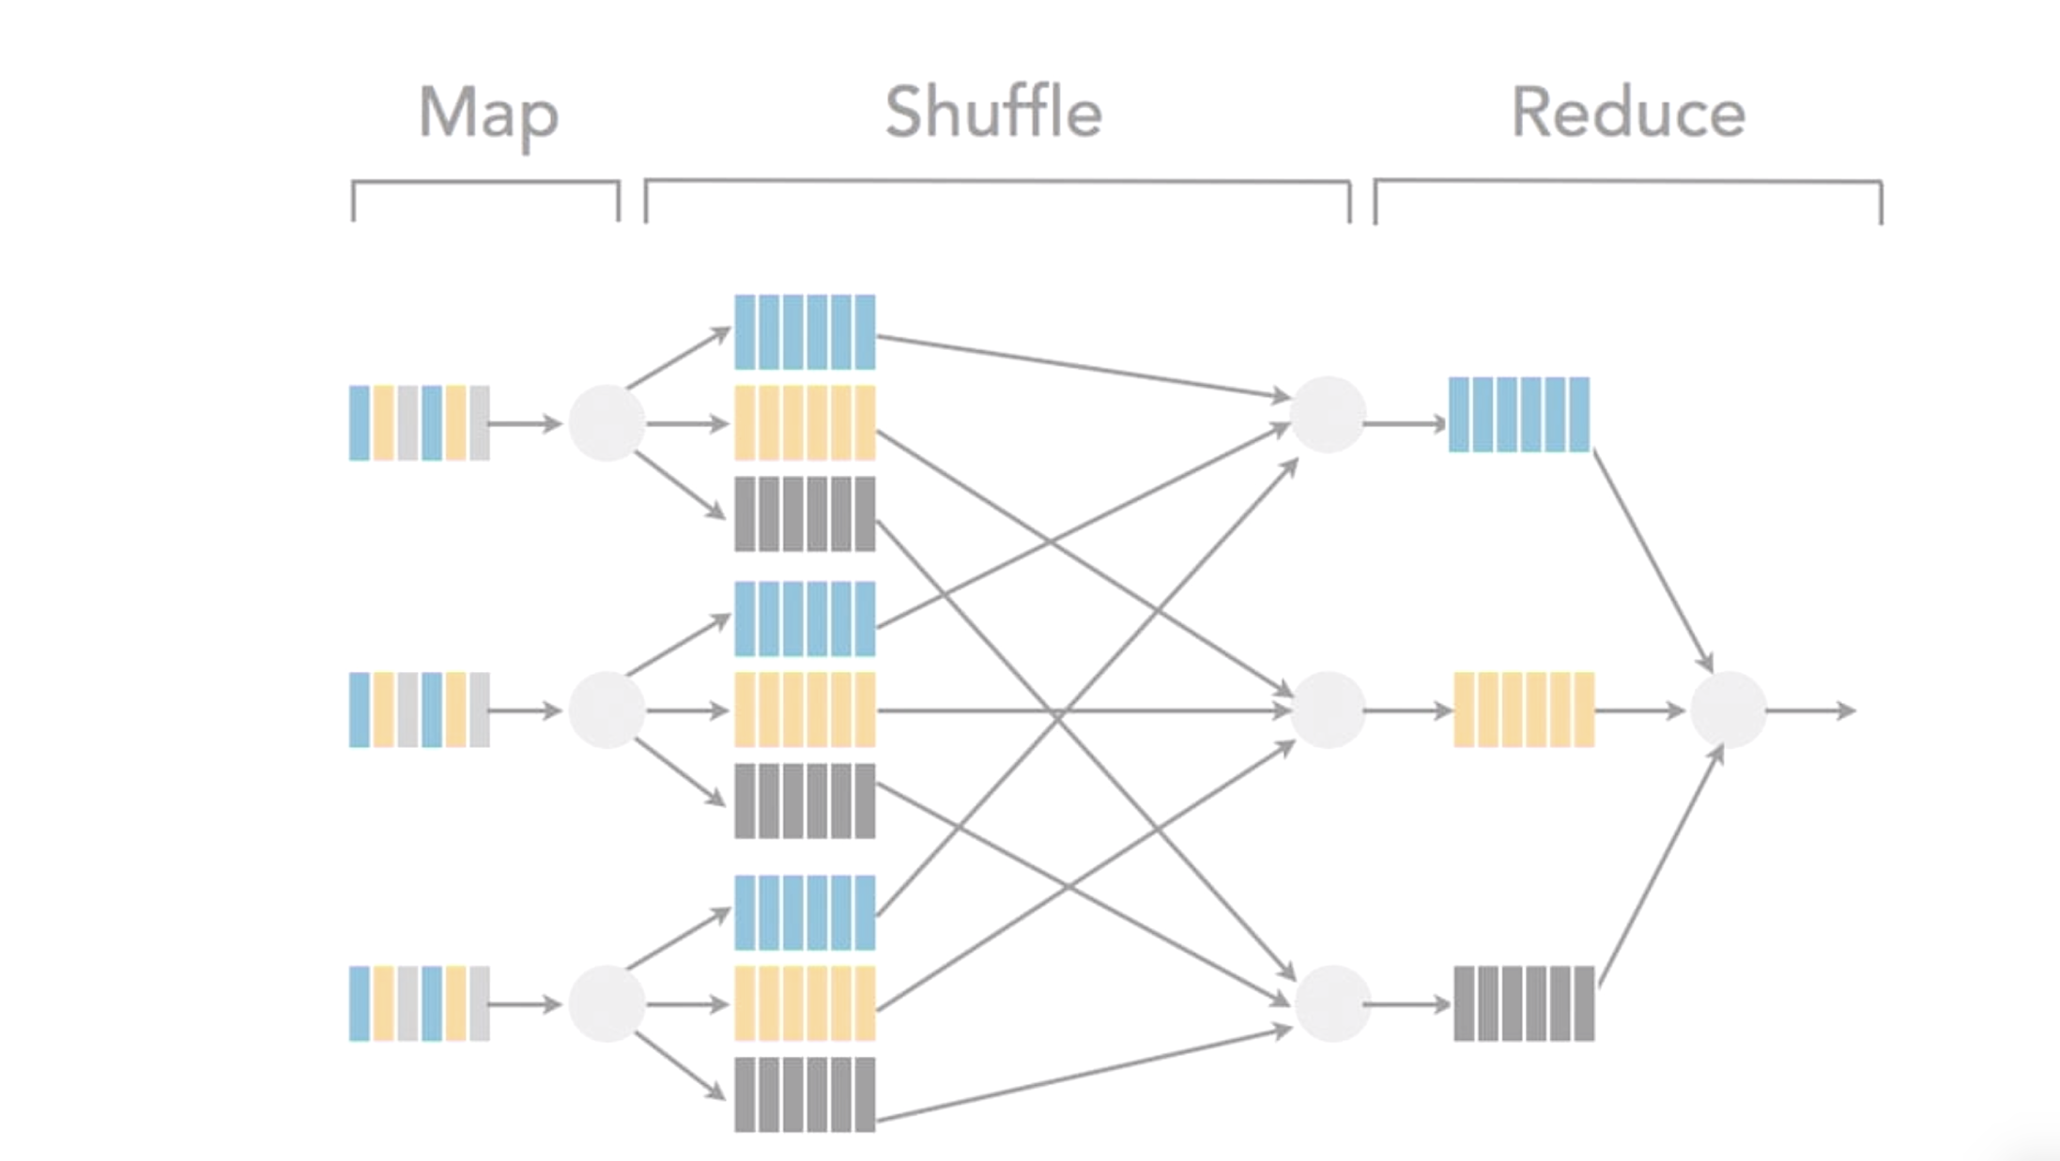
What is Hadoop?

Slide 16
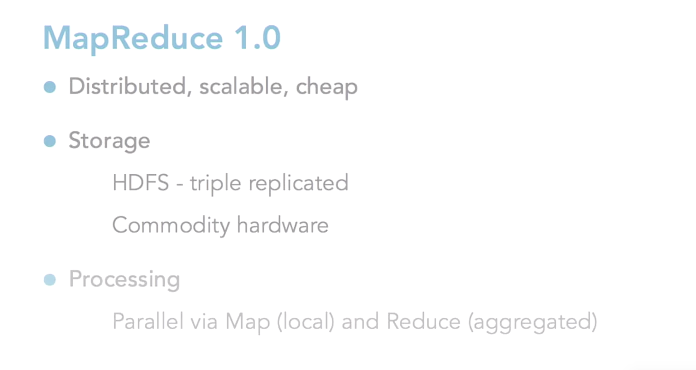
What is Hadoop?

Slide 17
What is Hadoop?
Hadoop is not a database, but it’s an alternative file system with a processing library
Hadoop will be addition to the Relational Database you have, not as a replacement for it

Slide 18
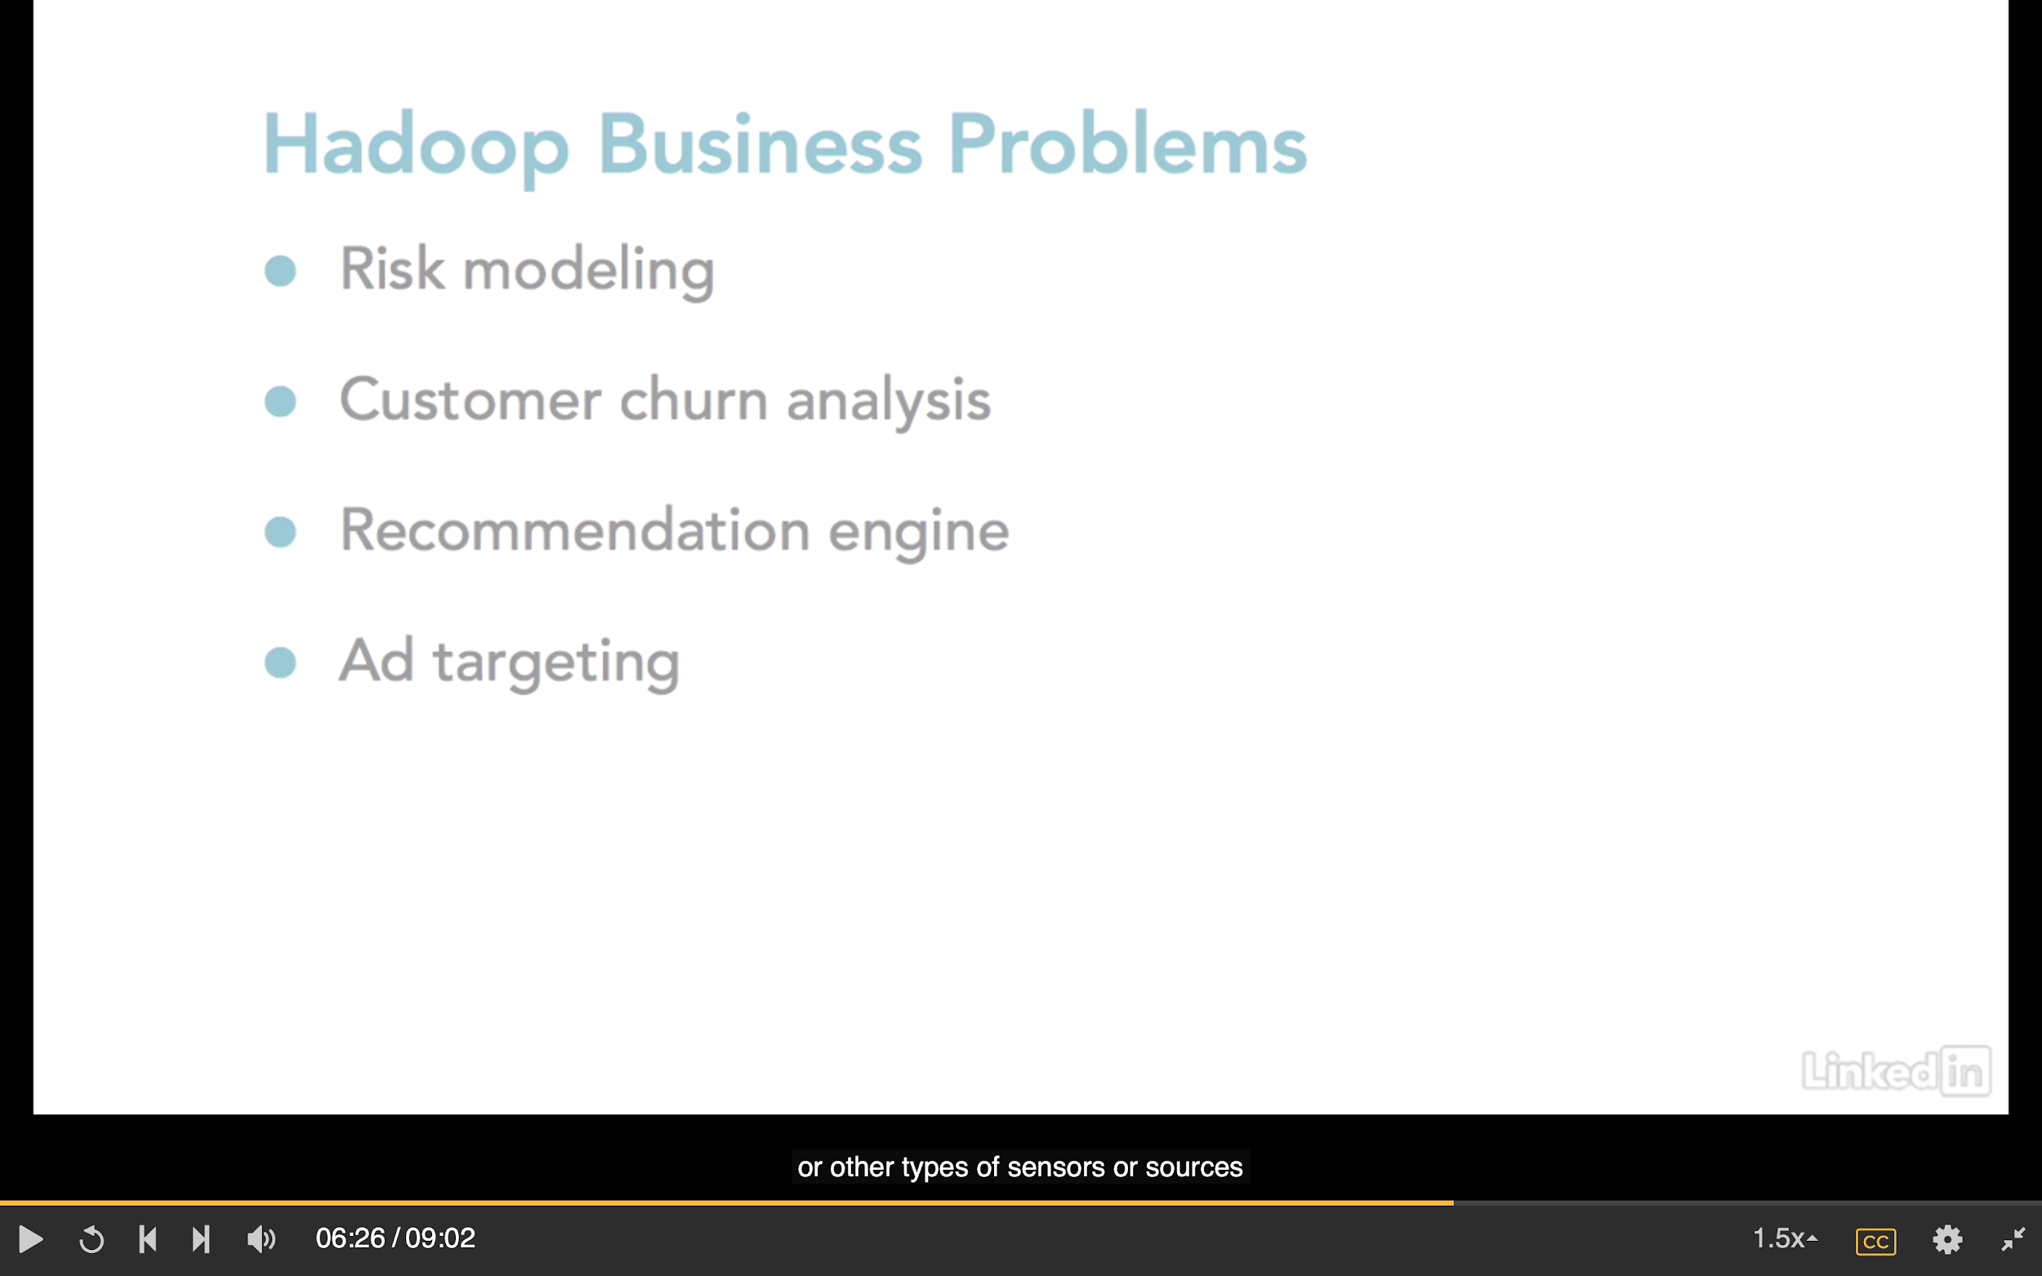
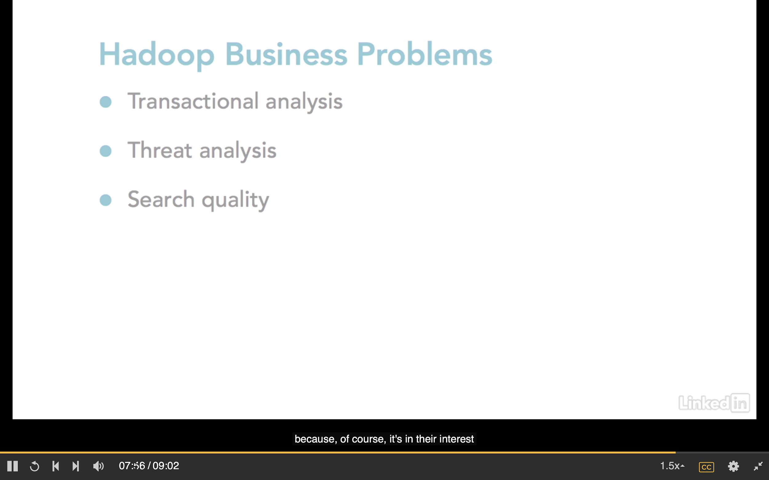
What is Hadoop? - Hadoop Business Problem
Cause a lot more to gain new customers as compared to secure the existing ones
e.g. credit card activities
e.g. Netflix
Collect large amount of data to see what we actually shopping

Slide 19
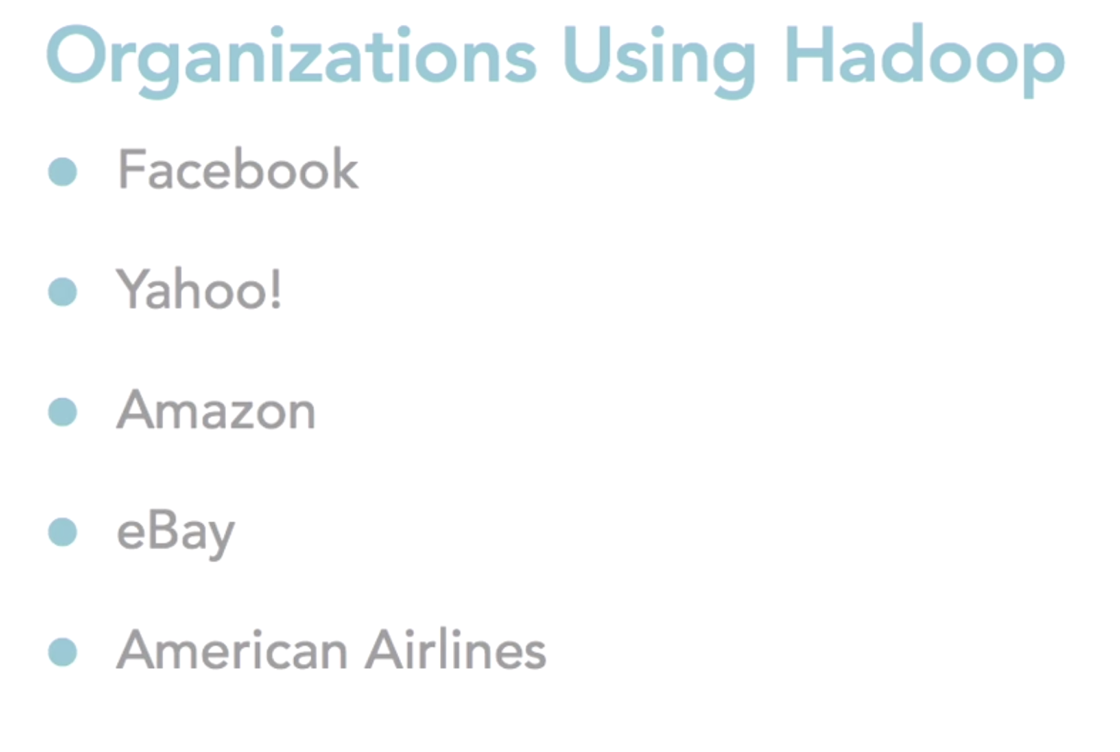
What is Hadoop?

Slide 20
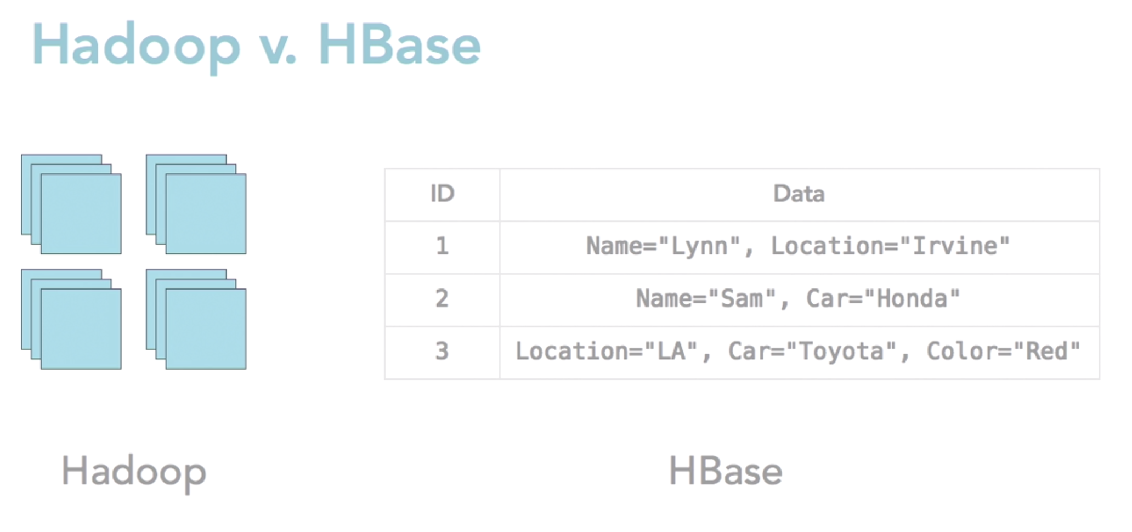
What is Hadoop? - Hadoop vs HBase
Use MapReduce directly with Hadoop is quite pain (like C++ for OOP)
Hadoop each file by default is replicated three times in Hadoop ecosystem on 3 different commodity hardware, size of files are also quite large 64 or 128 MB
(wide column store)

Slide 21
3. Understand Hadoop Core Components

Slide 22
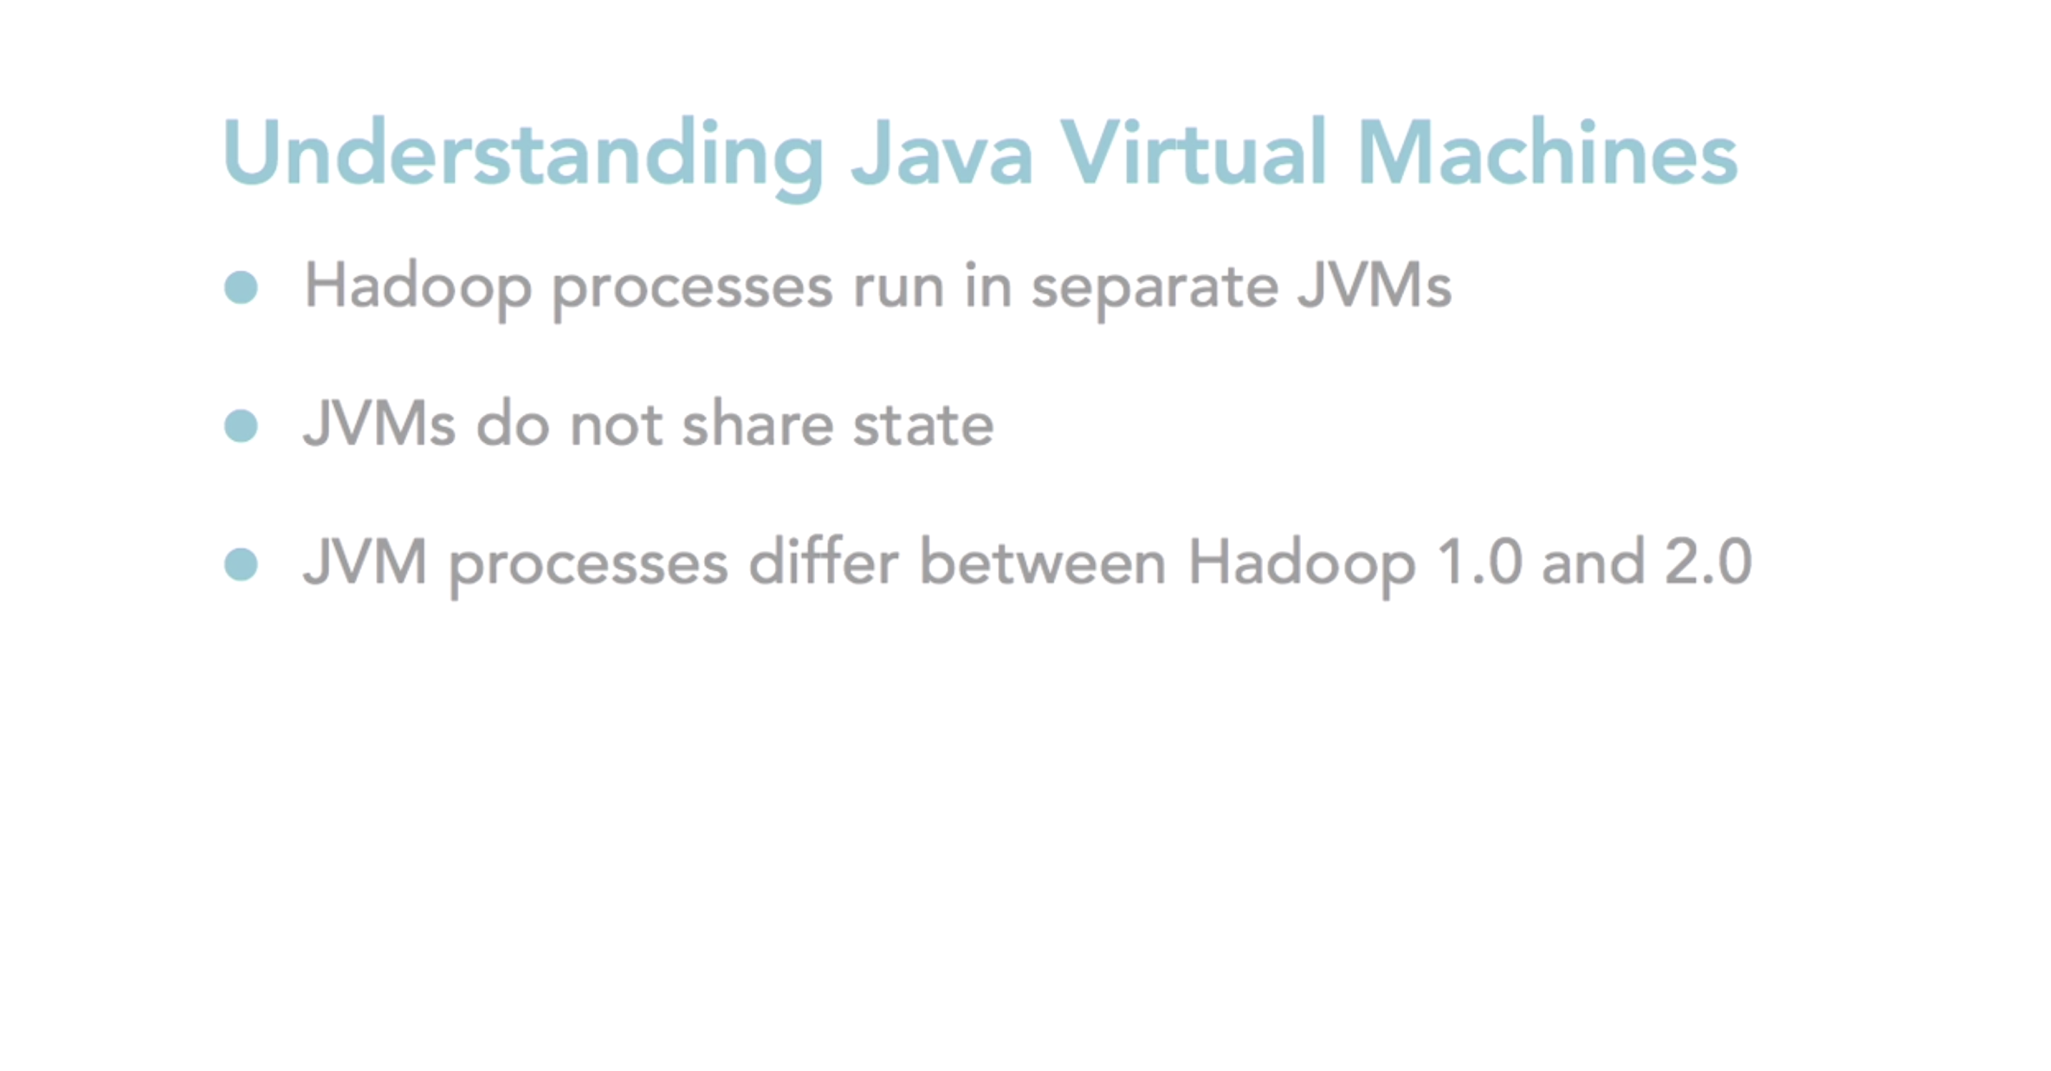
3.1 Java Virtual Machine (JVM)

Slide 23
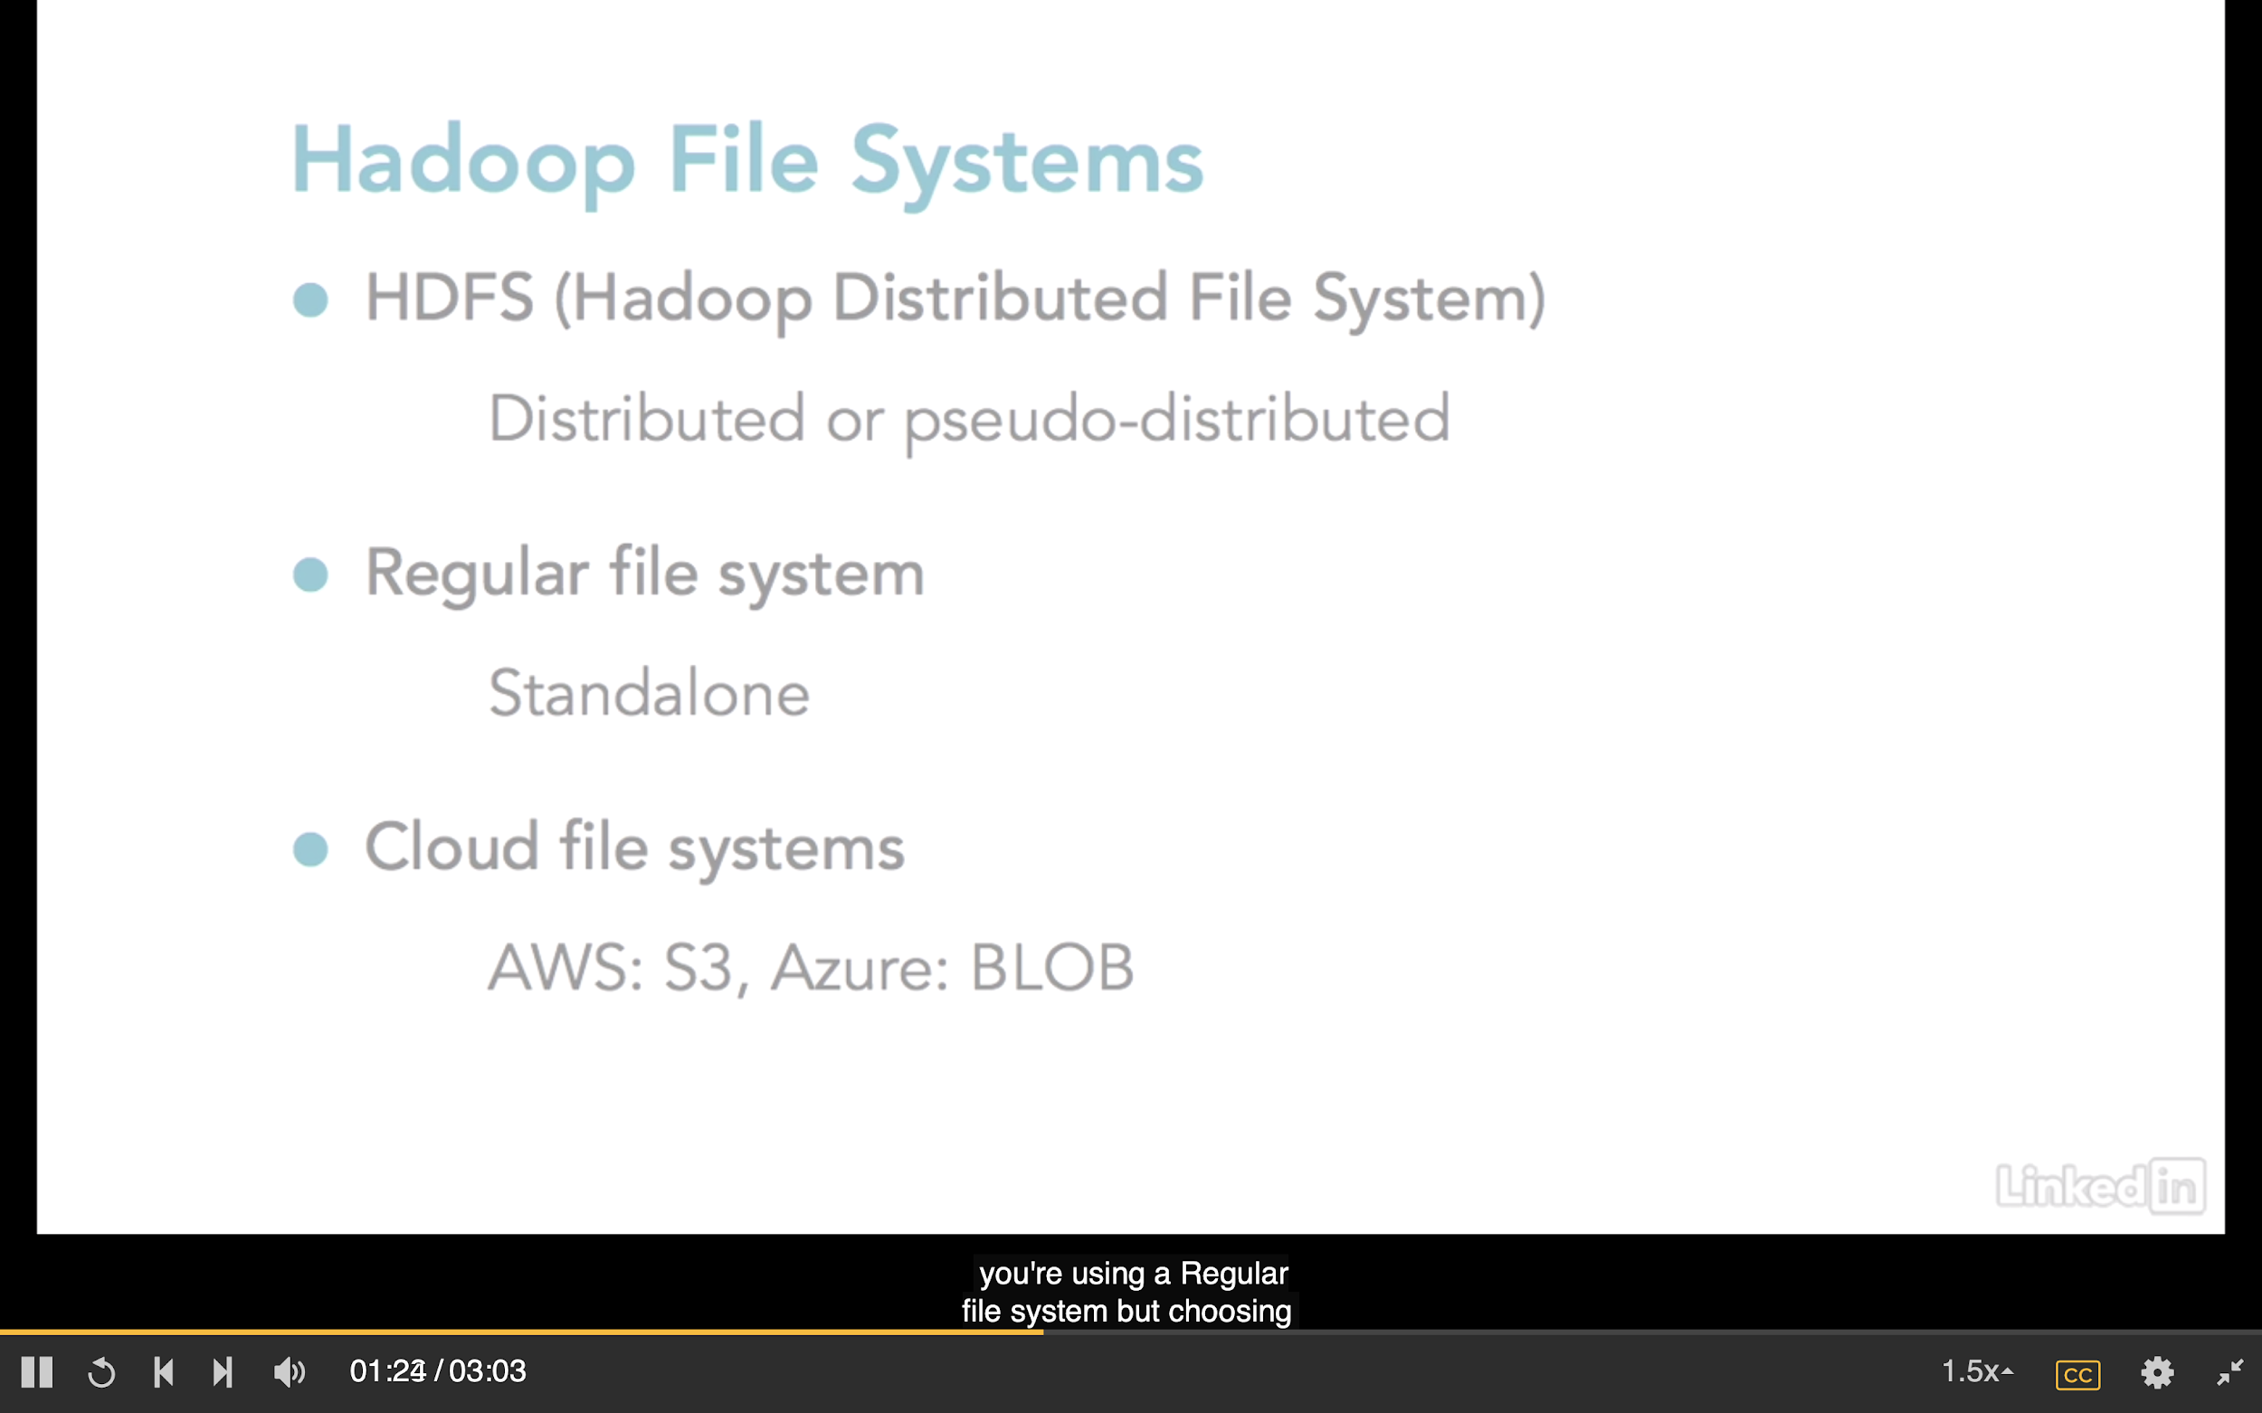
3.2 Hadoop File Systems
: Tripple replicated by default
2 modes:
designed for testing implemented on single node and single machine
3 copies
: Cloud based file system
: Good for one who just learn MapReduce

Slide 24
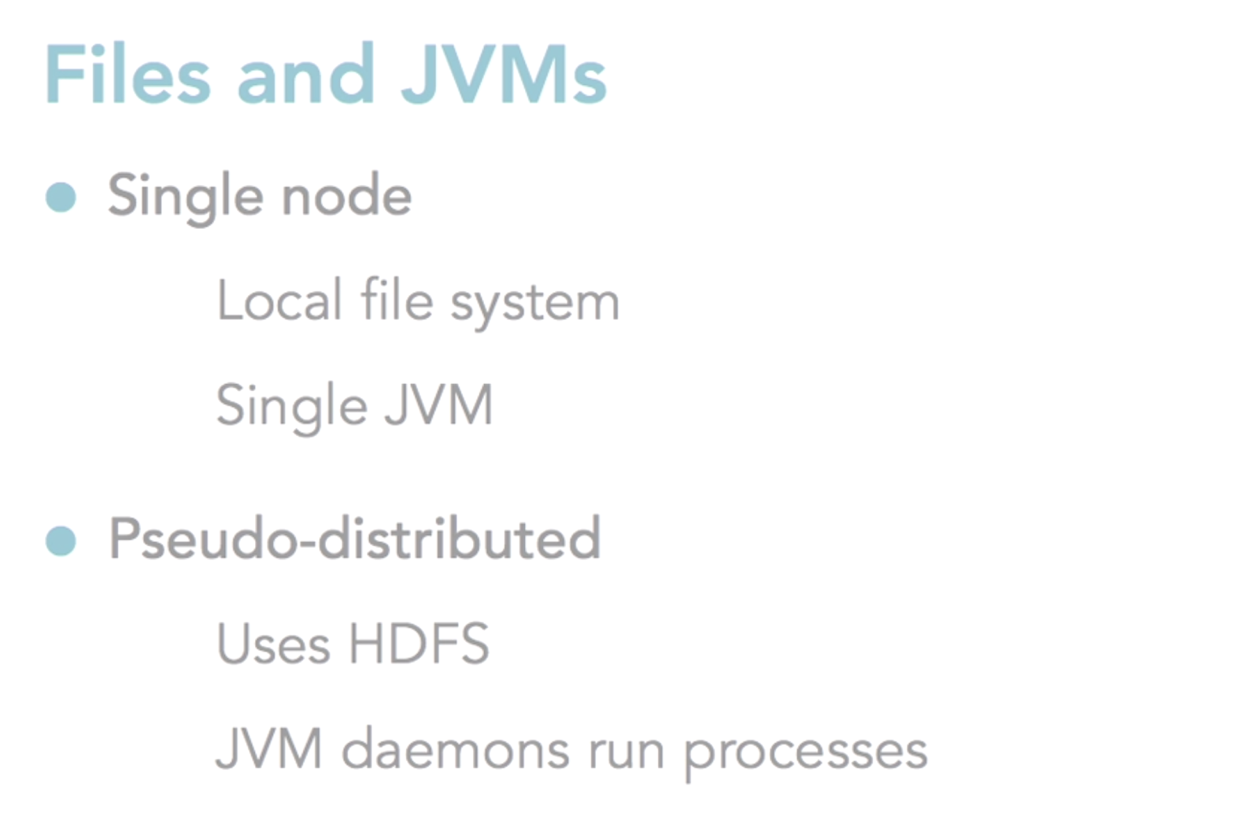
3.2 Hadoop File Systems
: Cloud based file system

Slide 25
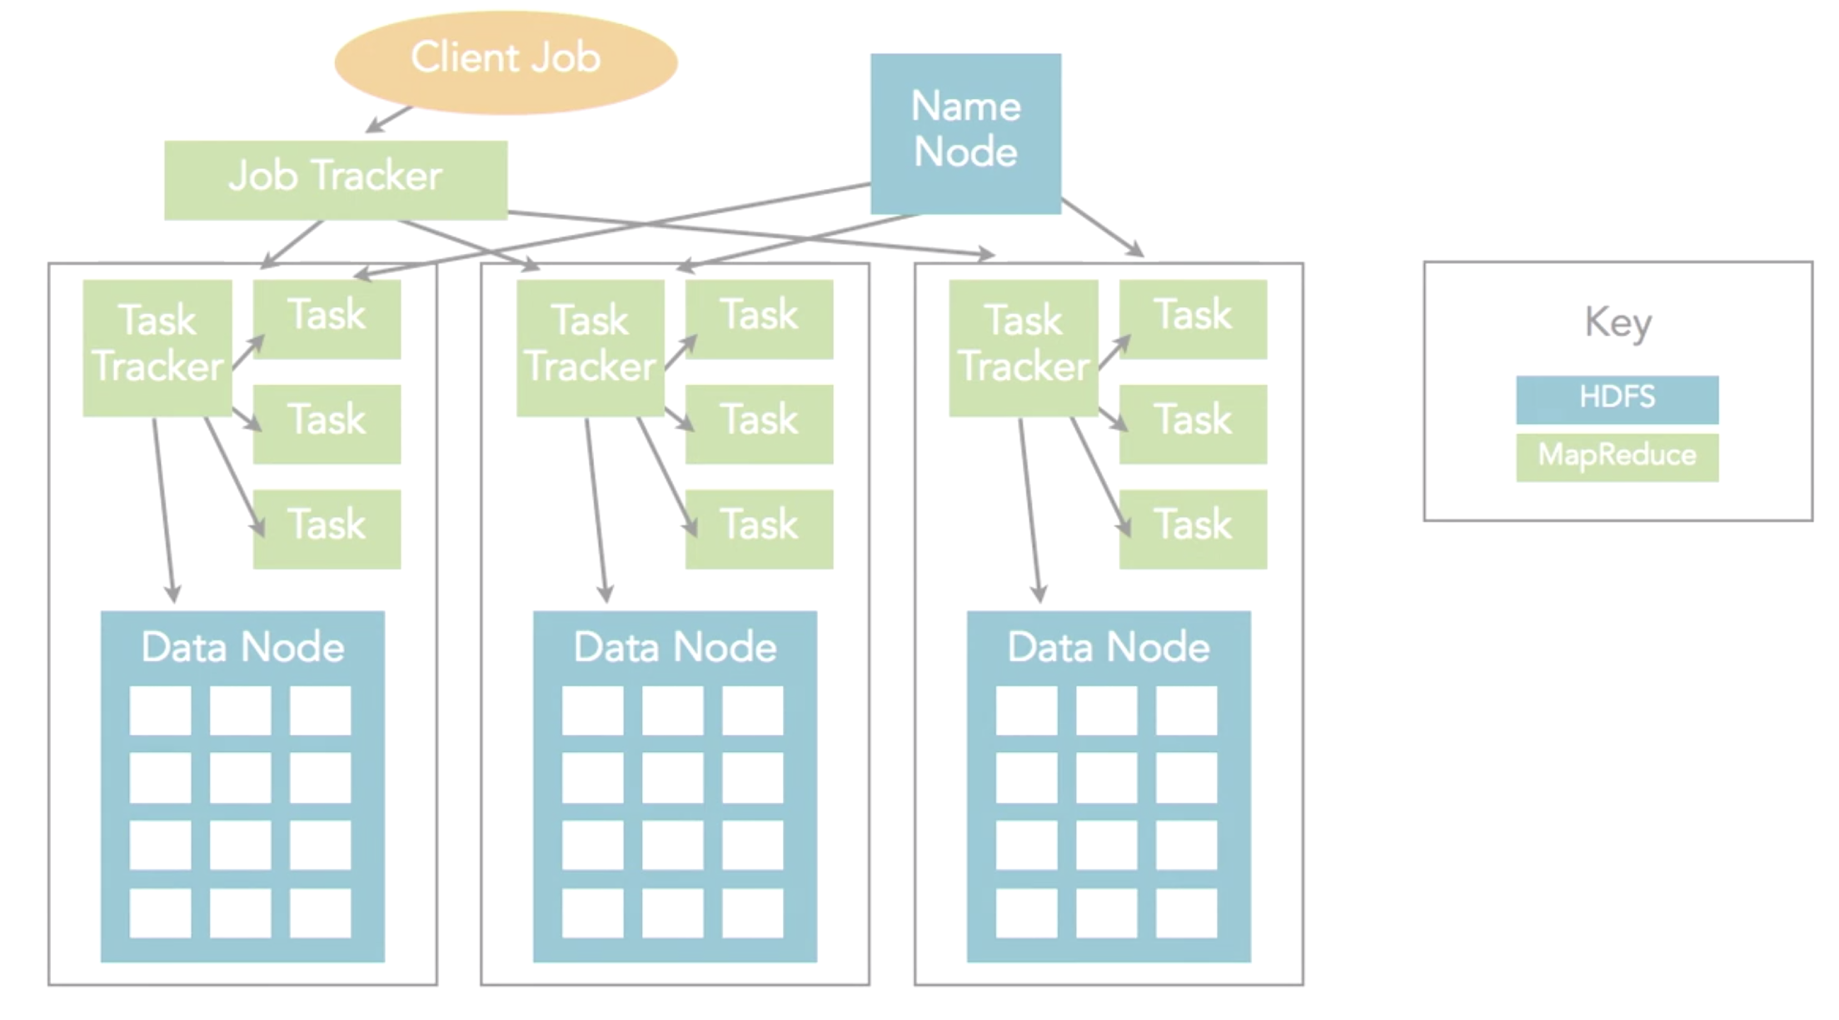
3.2 Hadoop File Systems
Fully distributed mode
3 servers
Each server has various daemons (represented in green)
Job tracker daemon implemented on a different physical server
Daemons control data distribution: Name Node and Data Nodes
In production, separate JVMs do not share state

Slide 26
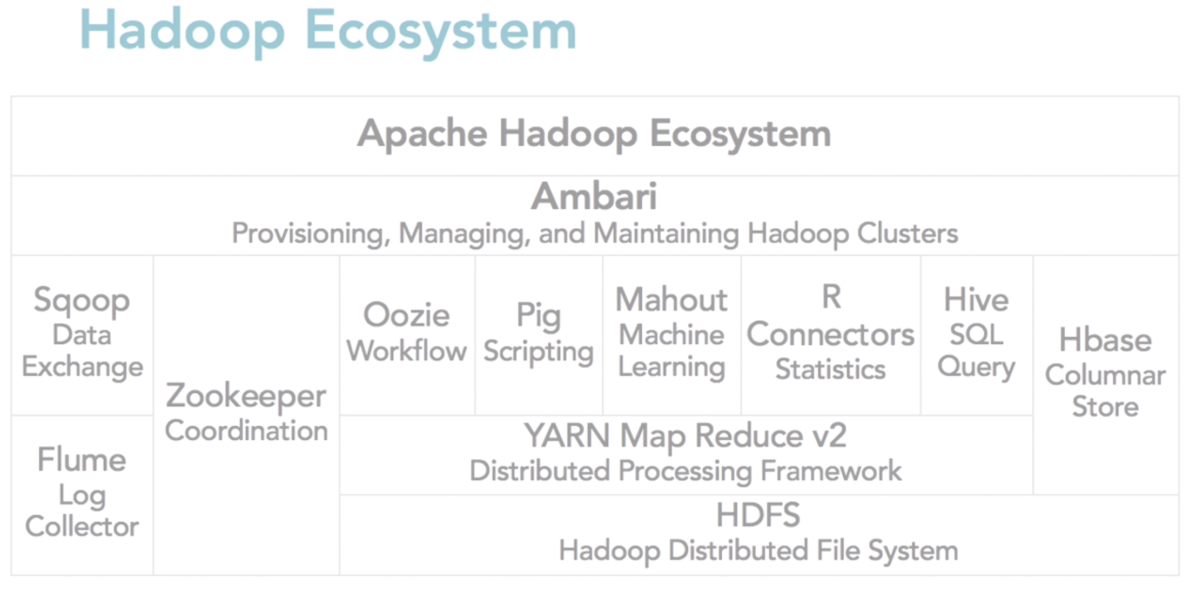
3.3 Hadoop Cluster Components
Notes:
YARN = Yet Another Resource Negotiator
MapReduce 2 is more commonly use
HBase query column store abstraction on top of HDFS
HiVE = HQL -> use to query HBase
Pig = used forr ETL-Like Processes
Mahout = for machine learning or predictive analytics
Oozie = workflow or coordination of jobs
Zookeper = coordination of group of jobs
Scoop for data exchange in between other systems particulary relational systems like SQL server and Hadoop
Flume = log collector since Hadoop jobs produce a large amount of log information about job process because jobs are running batch so it’ll takes time to run
Ambari=Provisioning, Managing, and Monitoring Hadoop Clusters

Slide 27
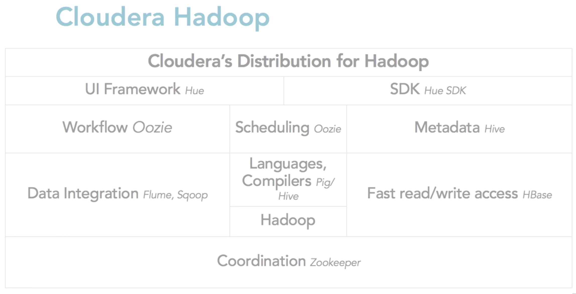
3.4 Cloudera Hadoop
Notes:
YARN = Yet Another Resource Negotiator
MapReduce 2 is more commonly use
HBase query column store abstraction on top of HDFS
HiVE = HQL -> use to query HBase
Pig = used forr ETL-Like Processes
Mahout = for machine learning or predictive analytics
Oozie = workflow or coordination of jobs
Zookeper = coordination of group of jobs
Scoop for data exchange in between other systems particulary relational systems like SQL server and Hadoop
Flume = log collector since Hadoop jobs produce a large amount of log information about job process because jobs are running batch so it’ll takes time to run
Ambari=Provisioning, Managing, and Monitoring Hadoop Clusters

Slide 28
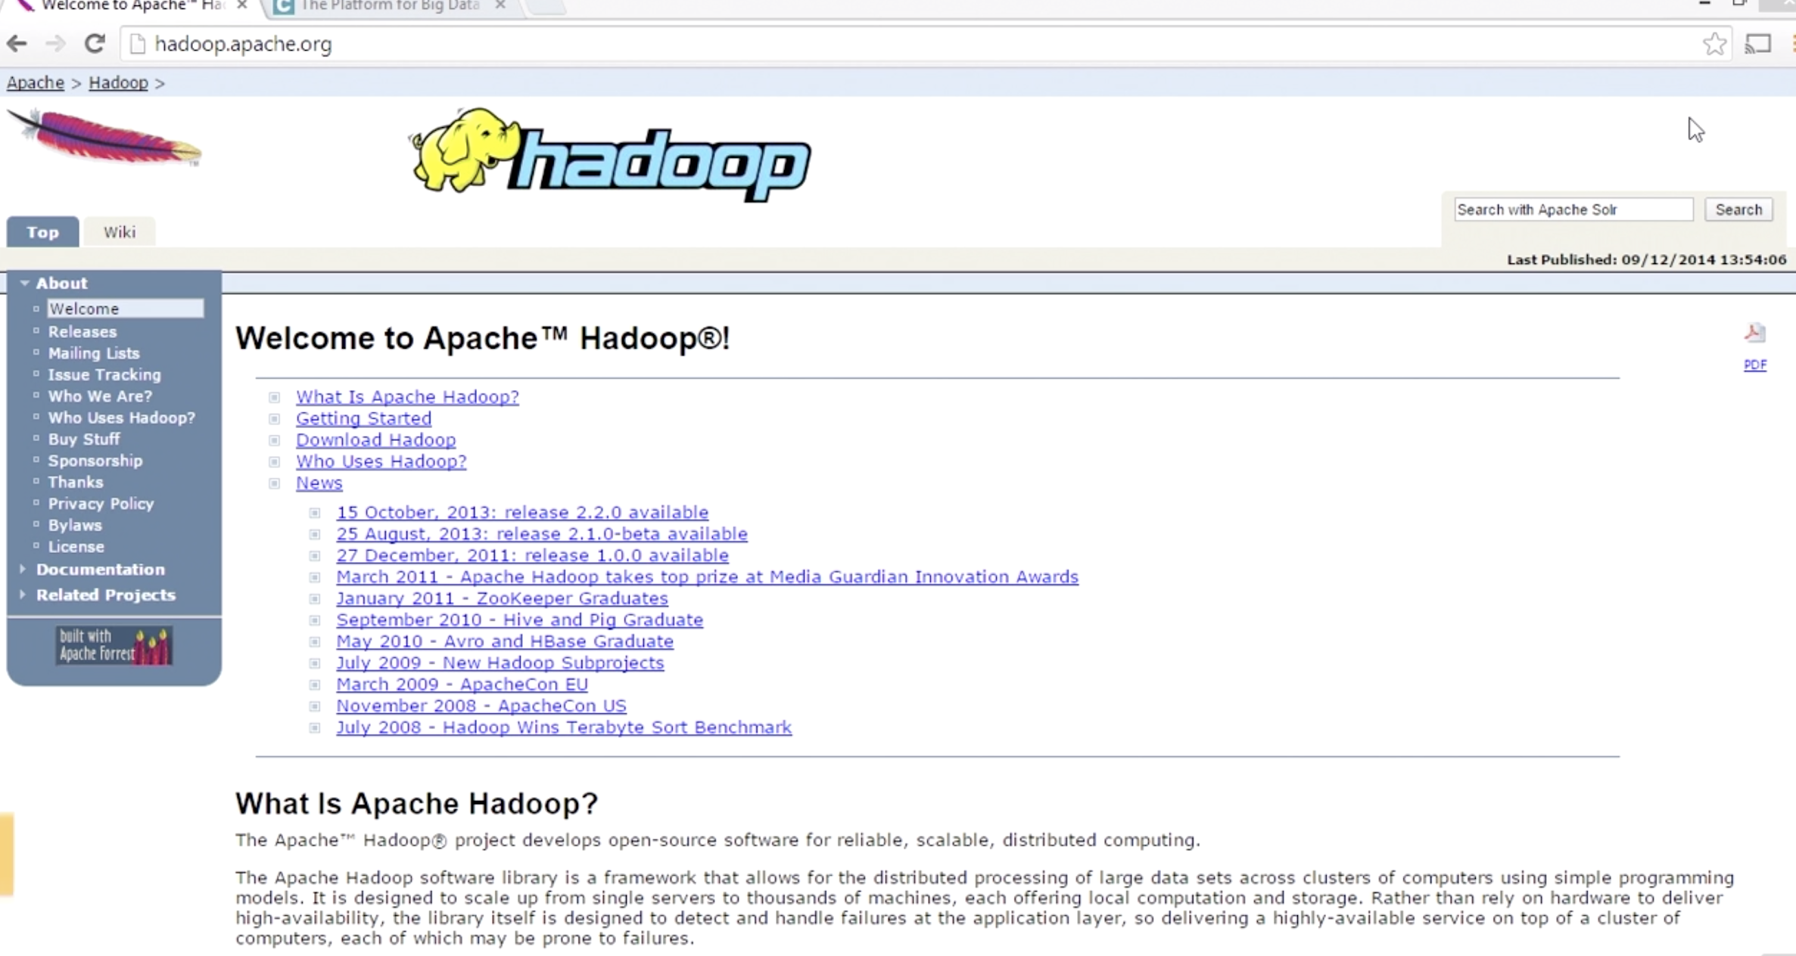
3.5 Apache and Cloudera Hadoop Distribution
Notes:
YARN = Yet Another Resource Negotiator
MapReduce 2 is more commonly use
HBase query column store abstraction on top of HDFS
HiVE = HQL -> use to query HBase
Pig = used forr ETL-Like Processes
Mahout = for machine learning or predictive analytics
Oozie = workflow or coordination of jobs
Zookeper = coordination of group of jobs
Scoop for data exchange in between other systems particulary relational systems like SQL server and Hadoop
Flume = log collector since Hadoop jobs produce a large amount of log information about job process because jobs are running batch so it’ll takes time to run
Ambari=Provisioning, Managing, and Monitoring Hadoop Clusters

Slide 29
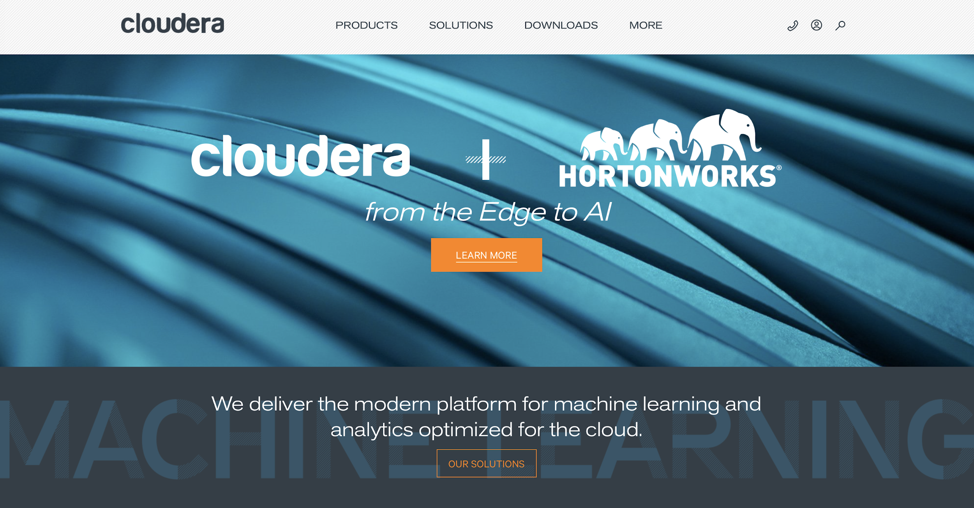
3.5 Apache and Cloudera Hadoop Distribution
https://www.cloudera.com
Notes:
YARN = Yet Another Resource Negotiator
MapReduce 2 is more commonly use
HBase query column store abstraction on top of HDFS
HiVE = HQL -> use to query HBase
Pig = used forr ETL-Like Processes
Mahout = for machine learning or predictive analytics
Oozie = workflow or coordination of jobs
Zookeper = coordination of group of jobs
Scoop for data exchange in between other systems particulary relational systems like SQL server and Hadoop
Flume = log collector since Hadoop jobs produce a large amount of log information about job process because jobs are running batch so it’ll takes time to run
Ambari=Provisioning, Managing, and Monitoring Hadoop Clusters

Slide 30
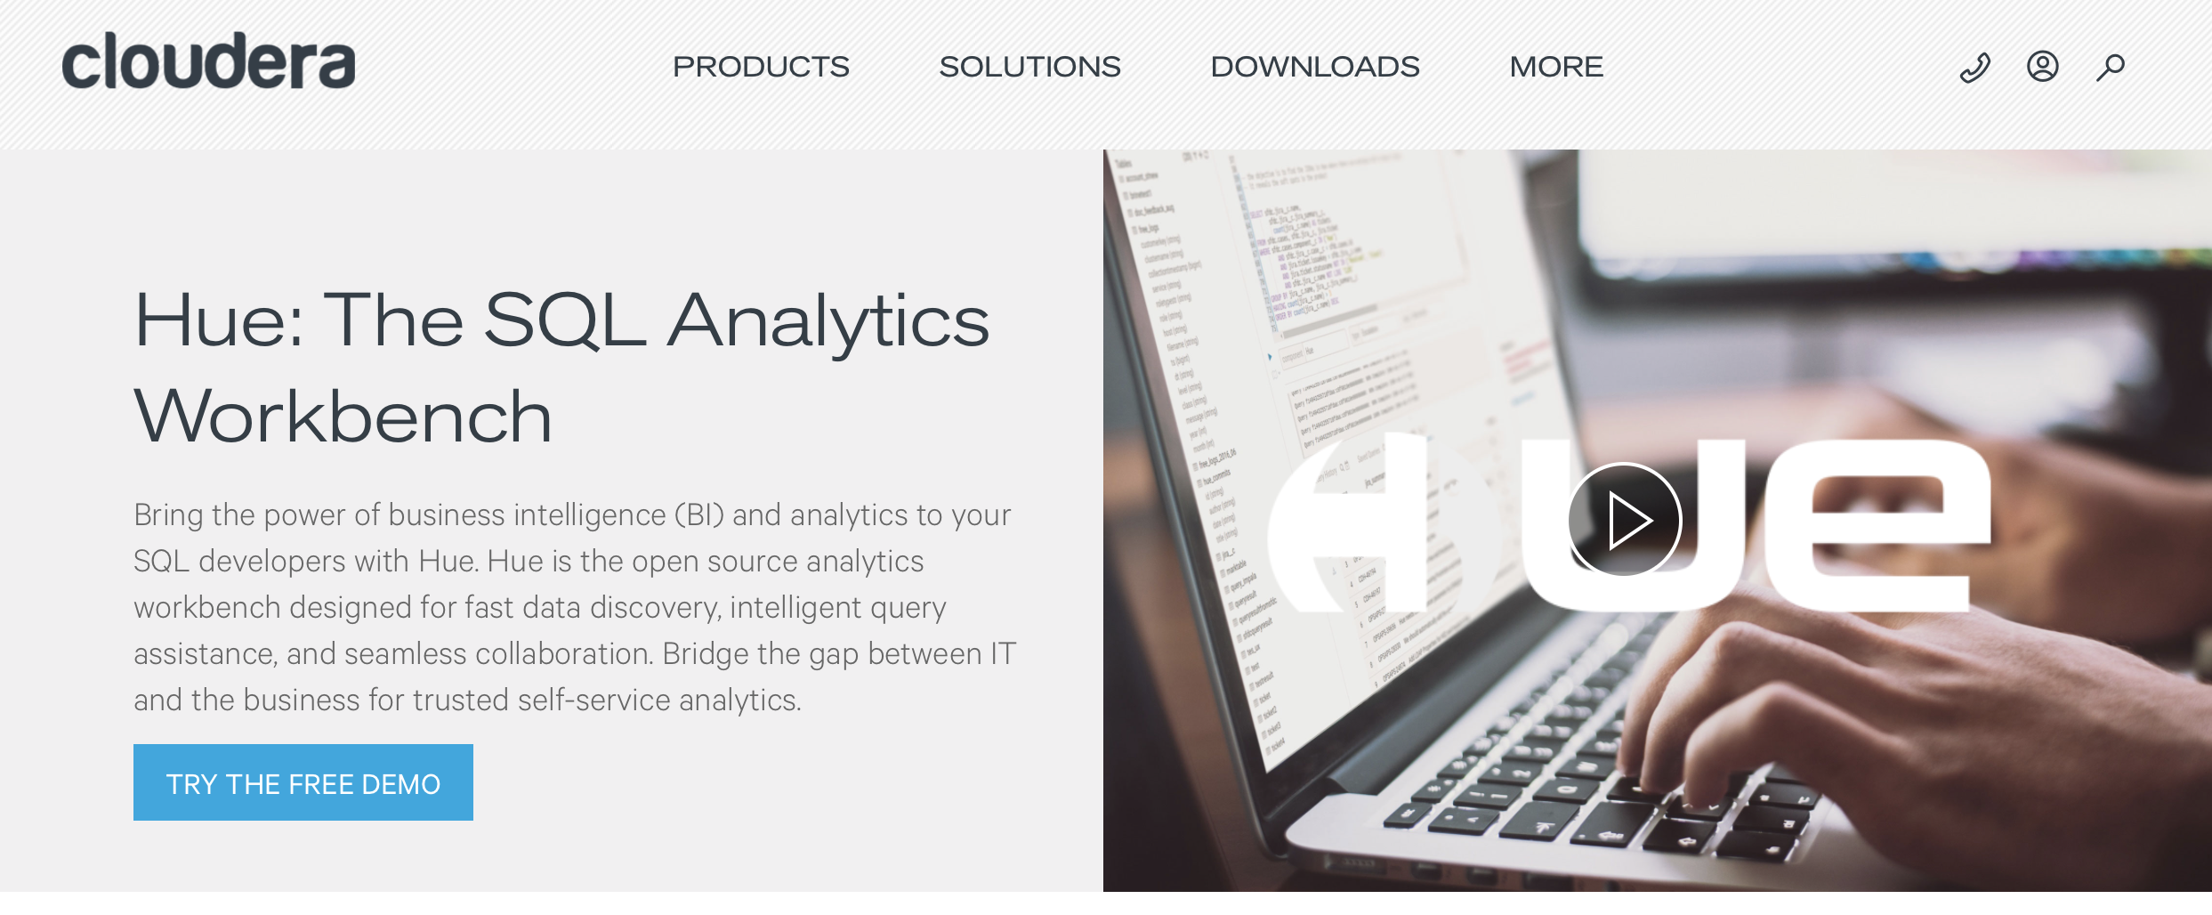
3.5 Apache and Cloudera Hadoop Distribution
https://www.cloudera.com/products/open-source/apache-hadoop/hue.html
Notes:
YARN = Yet Another Resource Negotiator
MapReduce 2 is more commonly use
HBase query column store abstraction on top of HDFS
HiVE = HQL -> use to query HBase
Pig = used forr ETL-Like Processes
Mahout = for machine learning or predictive analytics
Oozie = workflow or coordination of jobs
Zookeper = coordination of group of jobs
Scoop for data exchange in between other systems particulary relational systems like SQL server and Hadoop
Flume = log collector since Hadoop jobs produce a large amount of log information about job process because jobs are running batch so it’ll takes time to run
Ambari=Provisioning, Managing, and Monitoring Hadoop Clusters

Slide 31
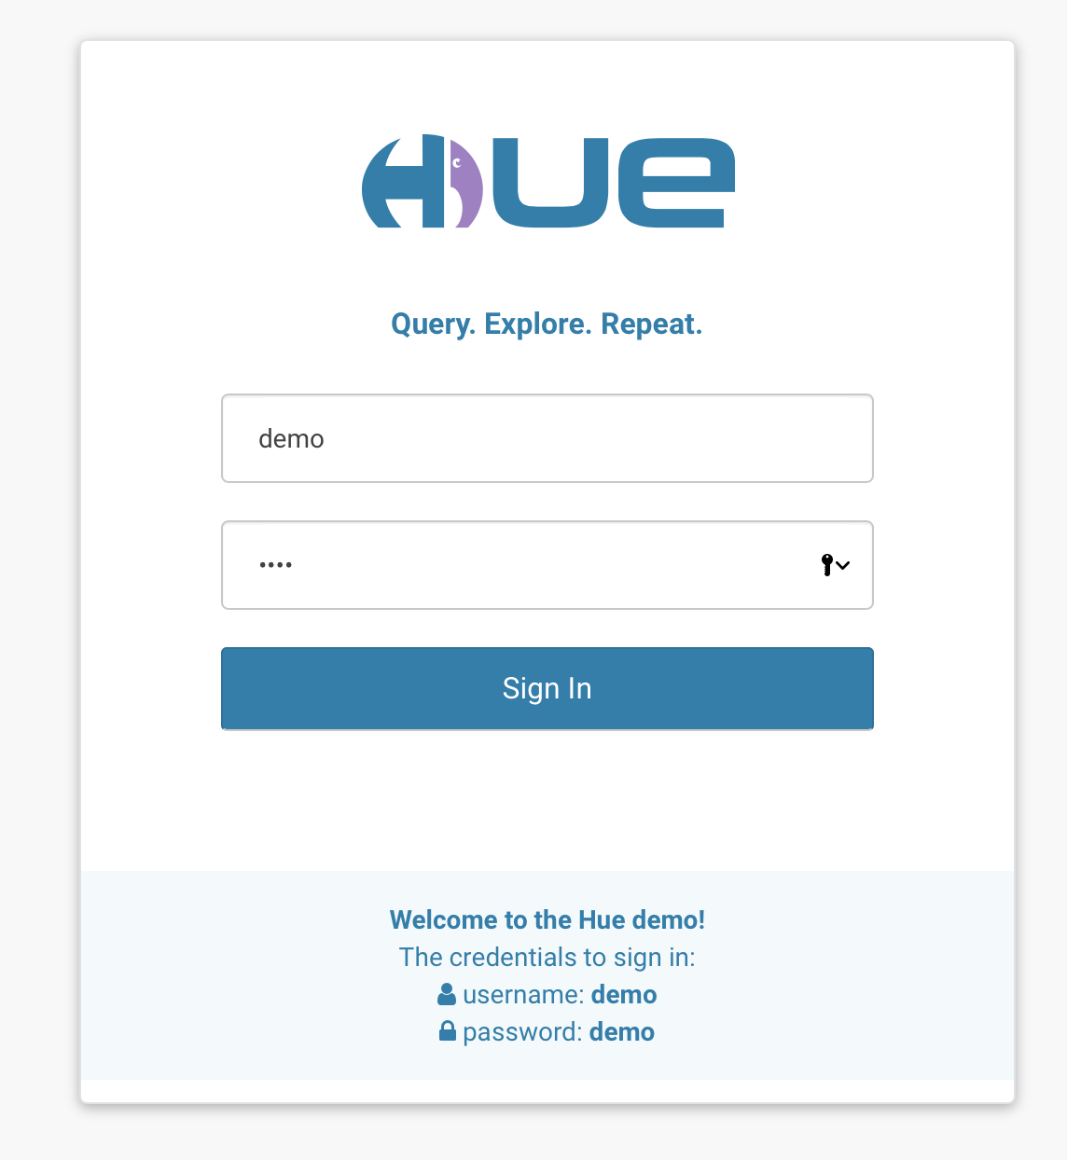
3.5 Apache and Cloudera Hadoop Distribution
Notes:
YARN = Yet Another Resource Negotiator
MapReduce 2 is more commonly use
HBase query column store abstraction on top of HDFS
HiVE = HQL -> use to query HBase
Pig = used forr ETL-Like Processes
Mahout = for machine learning or predictive analytics
Oozie = workflow or coordination of jobs
Zookeper = coordination of group of jobs
Scoop for data exchange in between other systems particulary relational systems like SQL server and Hadoop
Flume = log collector since Hadoop jobs produce a large amount of log information about job process because jobs are running batch so it’ll takes time to run
Ambari=Provisioning, Managing, and Monitoring Hadoop Clusters

Slide 32
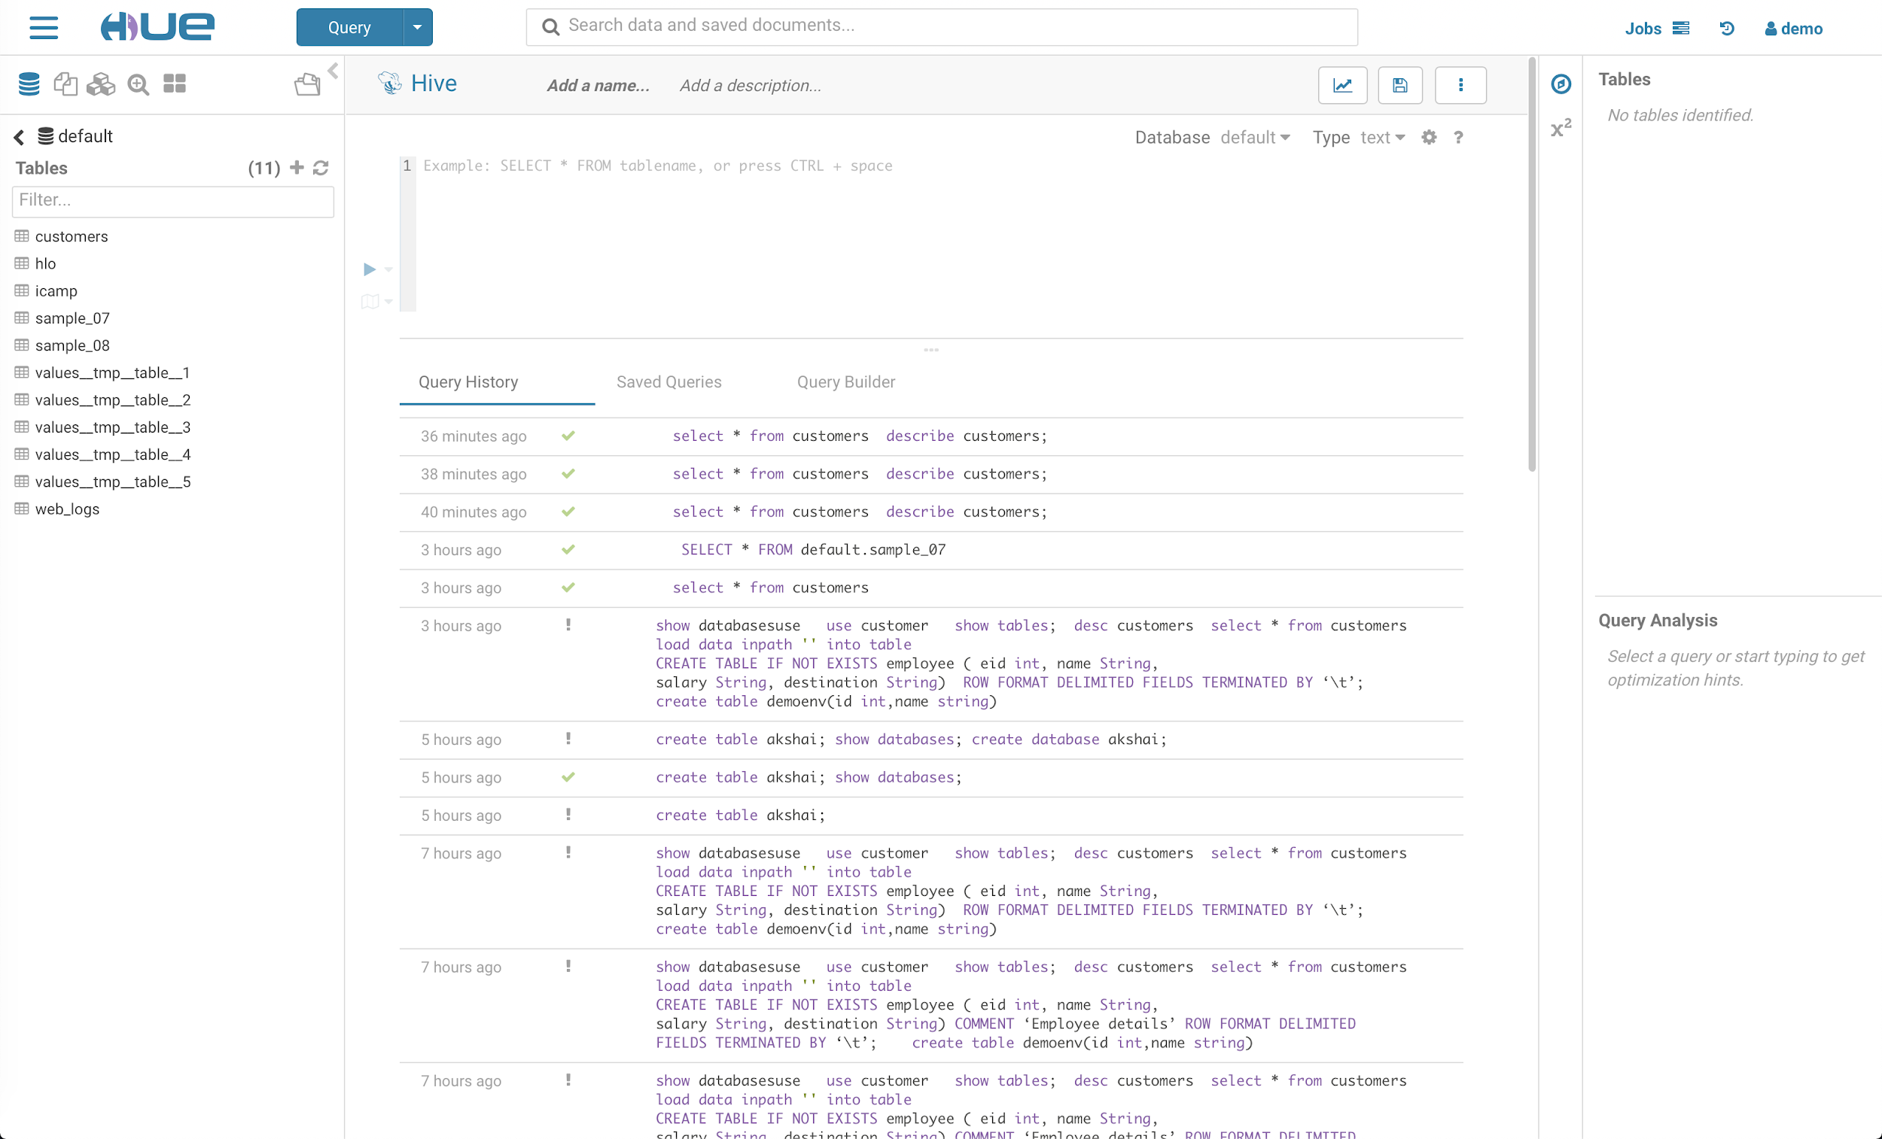
3.5 Apache and Cloudera Hadoop Distribution
Notes:
YARN = Yet Another Resource Negotiator
MapReduce 2 is more commonly use
HBase query column store abstraction on top of HDFS
HiVE = HQL -> use to query HBase
Pig = used forr ETL-Like Processes
Mahout = for machine learning or predictive analytics
Oozie = workflow or coordination of jobs
Zookeper = coordination of group of jobs
Scoop for data exchange in between other systems particulary relational systems like SQL server and Hadoop
Flume = log collector since Hadoop jobs produce a large amount of log information about job process because jobs are running batch so it’ll takes time to run
Ambari=Provisioning, Managing, and Monitoring Hadoop Clusters

Slide 33
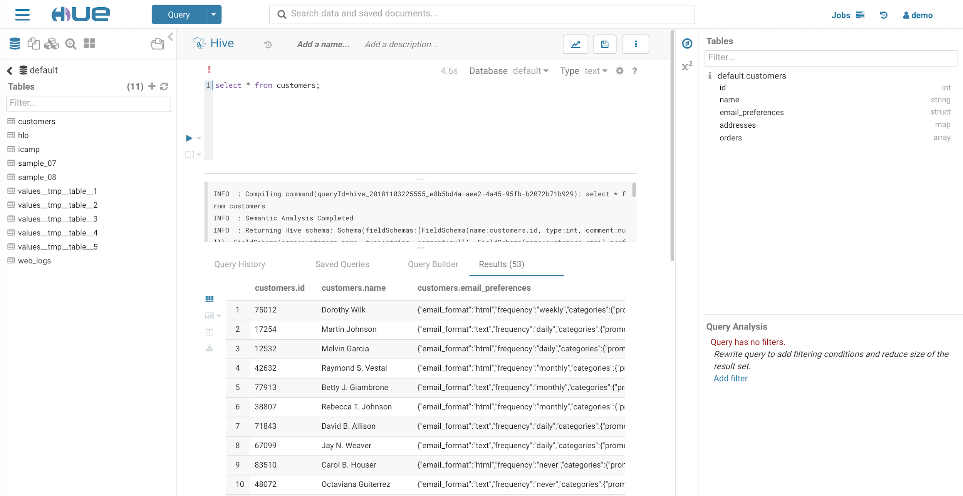
3.5 Apache and Cloudera Hadoop Distribution
Notes:
YARN = Yet Another Resource Negotiator
MapReduce 2 is more commonly use
HBase query column store abstraction on top of HDFS
HiVE = HQL -> use to query HBase
Pig = used forr ETL-Like Processes
Mahout = for machine learning or predictive analytics
Oozie = workflow or coordination of jobs
Zookeper = coordination of group of jobs
Scoop for data exchange in between other systems particulary relational systems like SQL server and Hadoop
Flume = log collector since Hadoop jobs produce a large amount of log information about job process because jobs are running batch so it’ll takes time to run
Ambari=Provisioning, Managing, and Monitoring Hadoop Clusters

Slide 34
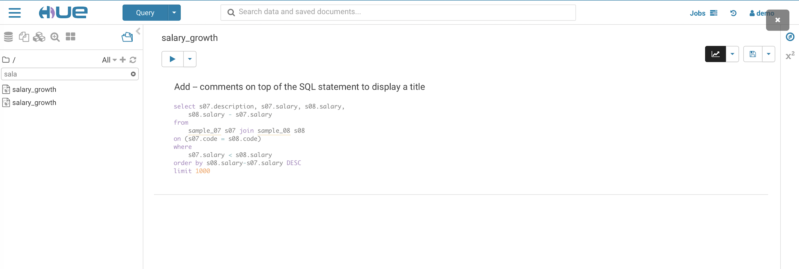
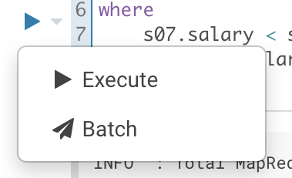
3.5 Apache and Cloudera Hadoop Distribution
Let’s try HiVE Query Language (HQL) - This is an abstraction over MapReduce
Click Execute!
Notes:
YARN = Yet Another Resource Negotiator
MapReduce 2 is more commonly use
HBase query column store abstraction on top of HDFS
HiVE = HQL -> use to query HBase
Pig = used forr ETL-Like Processes
Mahout = for machine learning or predictive analytics
Oozie = workflow or coordination of jobs
Zookeper = coordination of group of jobs
Scoop for data exchange in between other systems particulary relational systems like SQL server and Hadoop
Flume = log collector since Hadoop jobs produce a large amount of log information about job process because jobs are running batch so it’ll takes time to run
Ambari=Provisioning, Managing, and Monitoring Hadoop Clusters

Slide 35
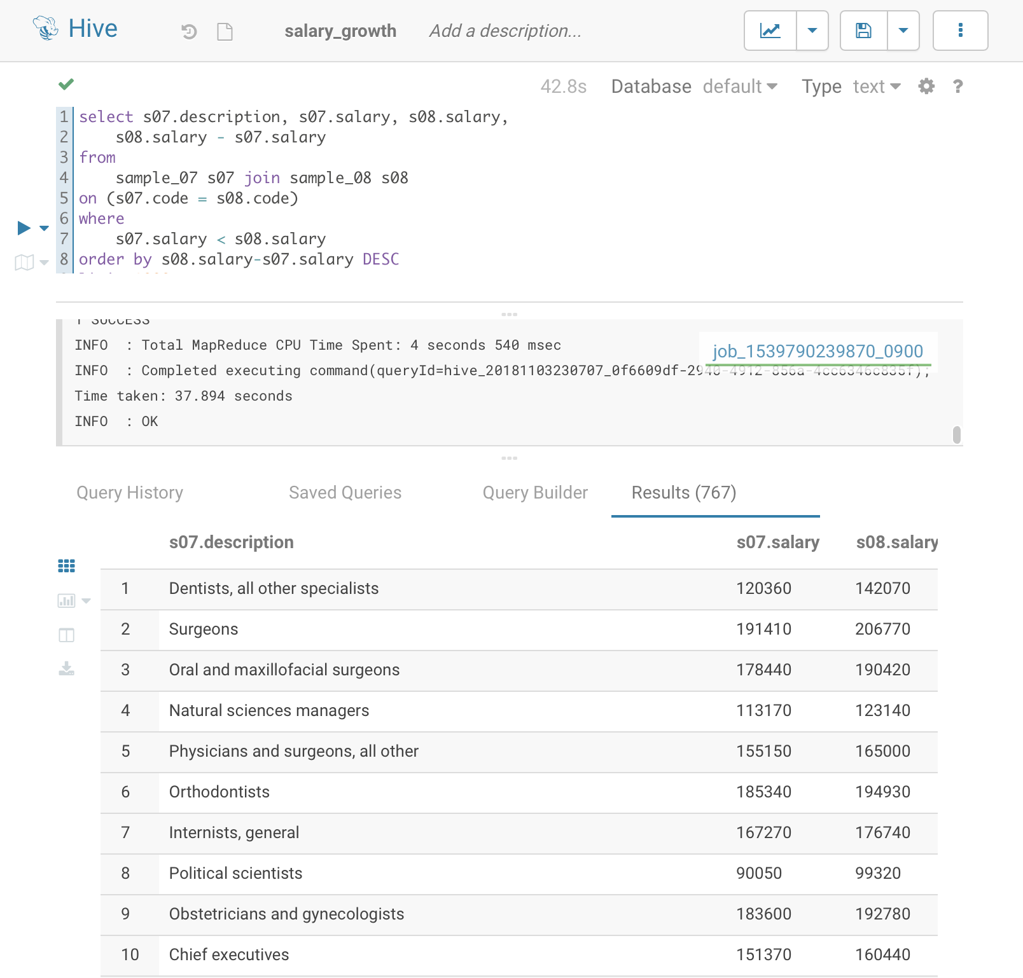
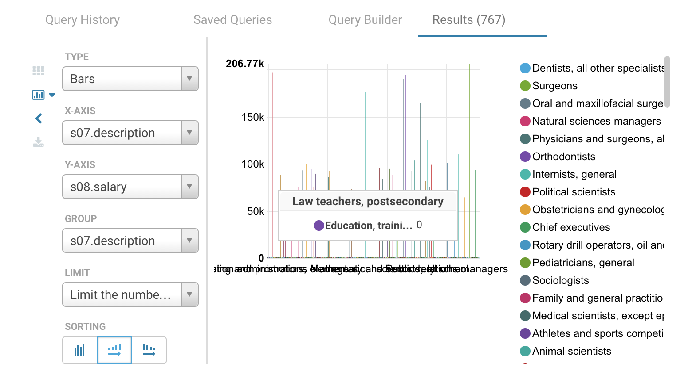
3.5 Apache and Cloudera Hadoop Distribution
Notes:
YARN = Yet Another Resource Negotiator
MapReduce 2 is more commonly use
HBase query column store abstraction on top of HDFS
HiVE = HQL -> use to query HBase
Pig = used forr ETL-Like Processes
Mahout = for machine learning or predictive analytics
Oozie = workflow or coordination of jobs
Zookeper = coordination of group of jobs
Scoop for data exchange in between other systems particulary relational systems like SQL server and Hadoop
Flume = log collector since Hadoop jobs produce a large amount of log information about job process because jobs are running batch so it’ll takes time to run
Ambari=Provisioning, Managing, and Monitoring Hadoop Clusters

Slide 36
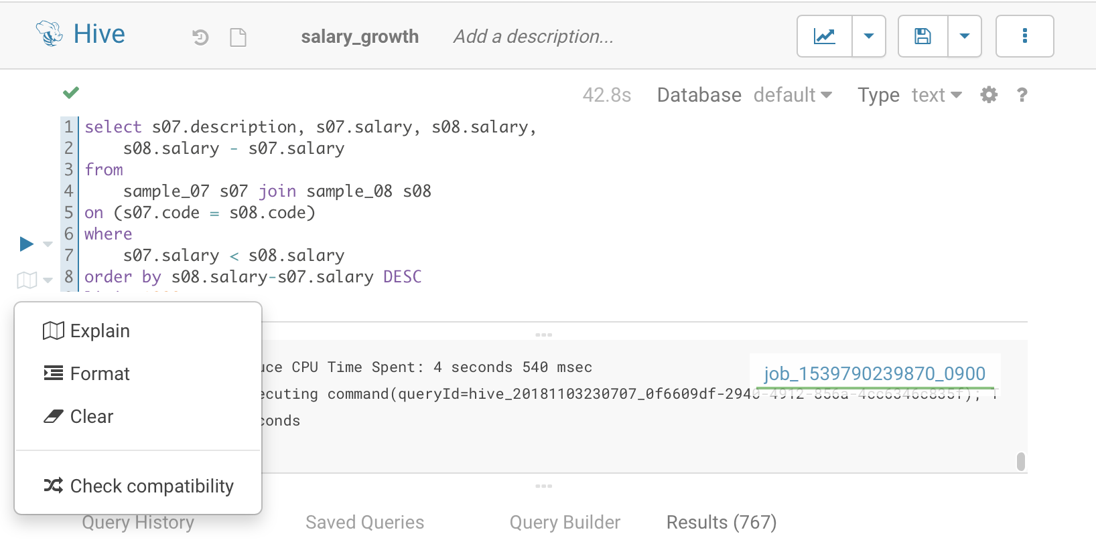
3.5 Apache and Cloudera Hadoop Distribution
Click Explain
Notes:
YARN = Yet Another Resource Negotiator
MapReduce 2 is more commonly use
HBase query column store abstraction on top of HDFS
HiVE = HQL -> use to query HBase
Pig = used forr ETL-Like Processes
Mahout = for machine learning or predictive analytics
Oozie = workflow or coordination of jobs
Zookeper = coordination of group of jobs
Scoop for data exchange in between other systems particulary relational systems like SQL server and Hadoop
Flume = log collector since Hadoop jobs produce a large amount of log information about job process because jobs are running batch so it’ll takes time to run
Ambari=Provisioning, Managing, and Monitoring Hadoop Clusters

Slide 37
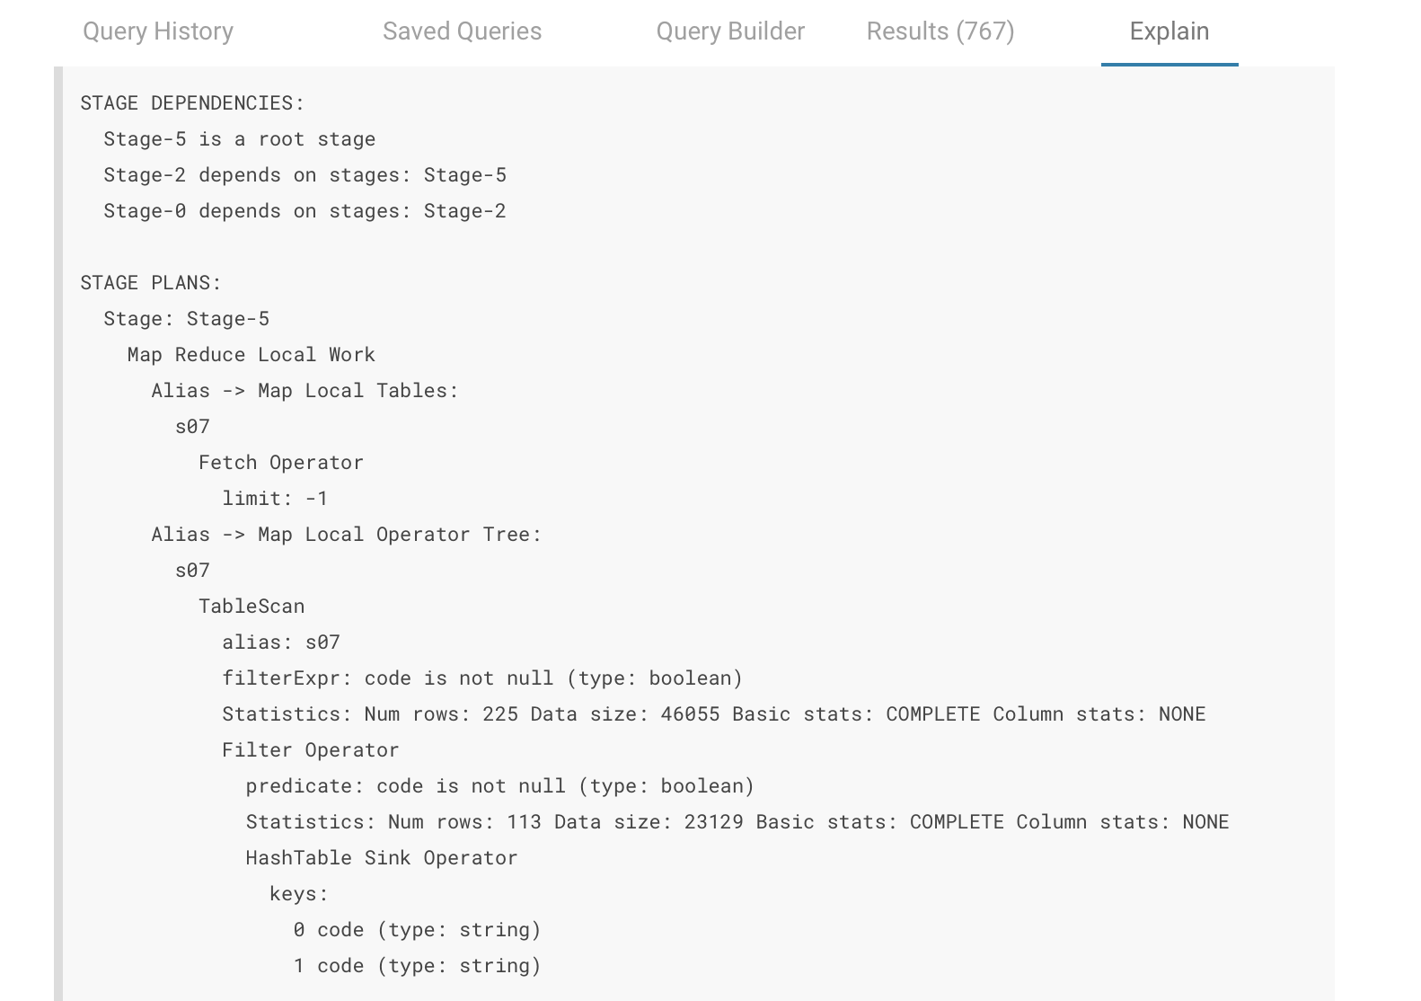
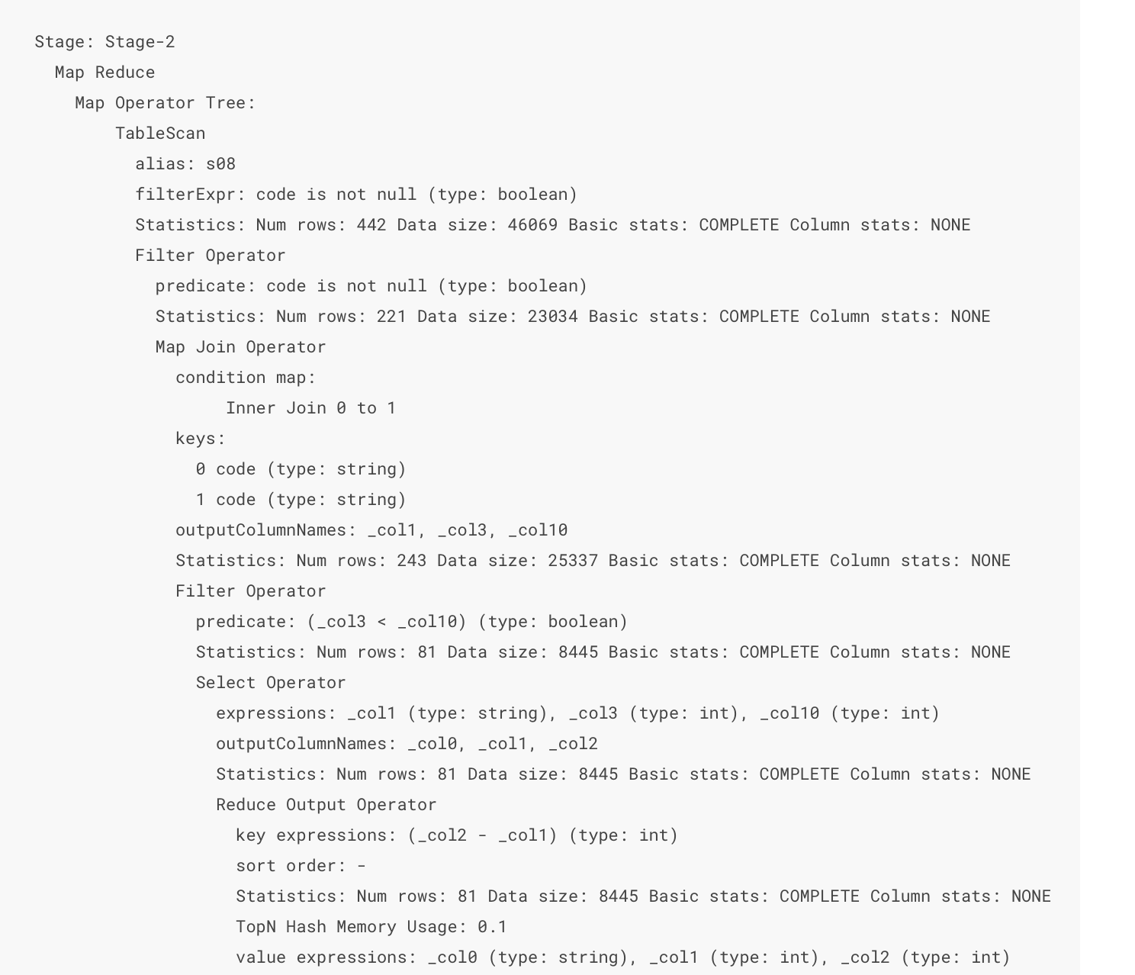
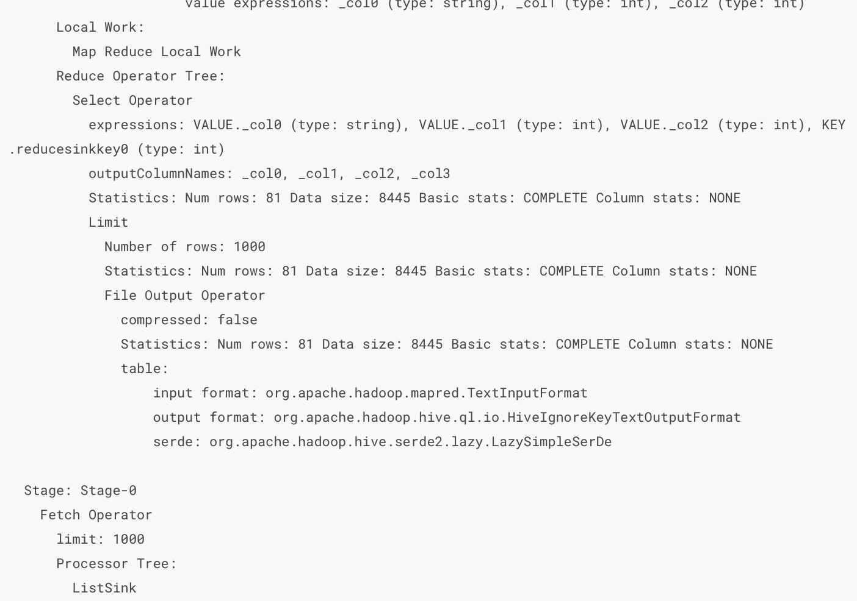
3.5 Apache and Cloudera Hadoop Distribution
This is very different implementation than what we did in relational database
Notes:
YARN = Yet Another Resource Negotiator
MapReduce 2 is more commonly use
HBase query column store abstraction on top of HDFS
HiVE = HQL -> use to query HBase
Pig = used forr ETL-Like Processes
Mahout = for machine learning or predictive analytics
Oozie = workflow or coordination of jobs
Zookeper = coordination of group of jobs
Scoop for data exchange in between other systems particulary relational systems like SQL server and Hadoop
Flume = log collector since Hadoop jobs produce a large amount of log information about job process because jobs are running batch so it’ll takes time to run
Ambari=Provisioning, Managing, and Monitoring Hadoop Clusters

Slide 38
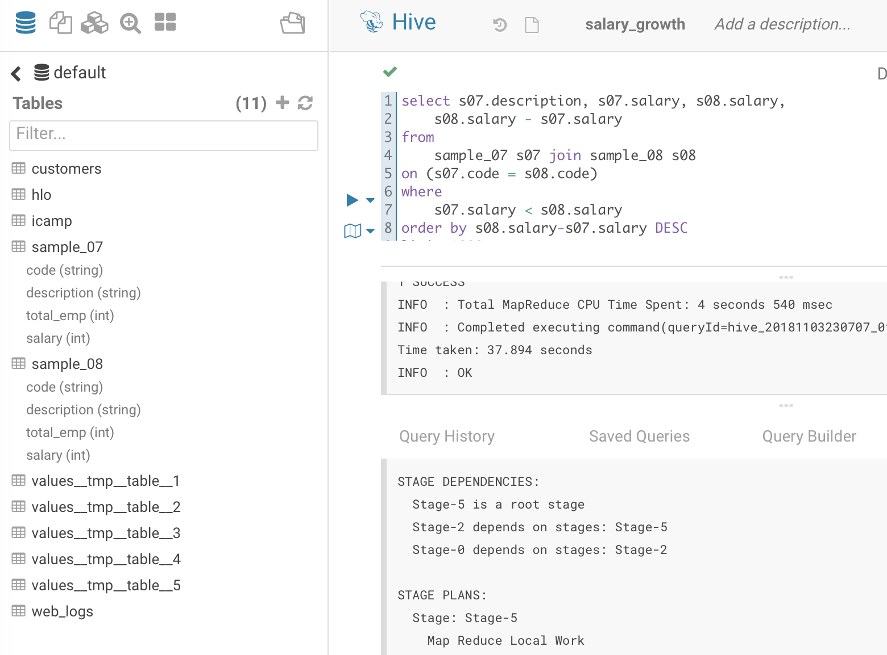
3.5 Apache and Cloudera Hadoop Distribution
This is very different implementation than Relational Database
Notes:
YARN = Yet Another Resource Negotiator
MapReduce 2 is more commonly use
HBase query column store abstraction on top of HDFS
HiVE = HQL -> use to query HBase
Pig = used forr ETL-Like Processes
Mahout = for machine learning or predictive analytics
Oozie = workflow or coordination of jobs
Zookeper = coordination of group of jobs
Scoop for data exchange in between other systems particulary relational systems like SQL server and Hadoop
Flume = log collector since Hadoop jobs produce a large amount of log information about job process because jobs are running batch so it’ll takes time to run
Ambari=Provisioning, Managing, and Monitoring Hadoop Clusters

Slide 39
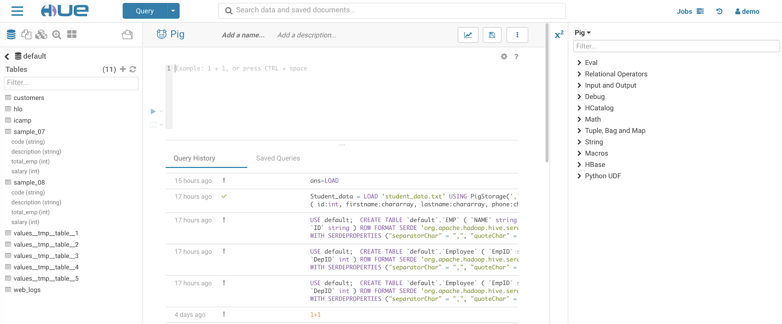
3.5 Apache and Cloudera Hadoop Distribution
Let’s try Pig (a language developed at Yahoo, at higher level of abstraction against MapReduce)
Notes:
YARN = Yet Another Resource Negotiator
MapReduce 2 is more commonly use
HBase query column store abstraction on top of HDFS
HiVE = HQL -> use to query HBase
Pig = used forr ETL-Like Processes
Mahout = for machine learning or predictive analytics
Oozie = workflow or coordination of jobs
Zookeper = coordination of group of jobs
Scoop for data exchange in between other systems particulary relational systems like SQL server and Hadoop
Flume = log collector since Hadoop jobs produce a large amount of log information about job process because jobs are running batch so it’ll takes time to run
Ambari=Provisioning, Managing, and Monitoring Hadoop Clusters

Slide 40
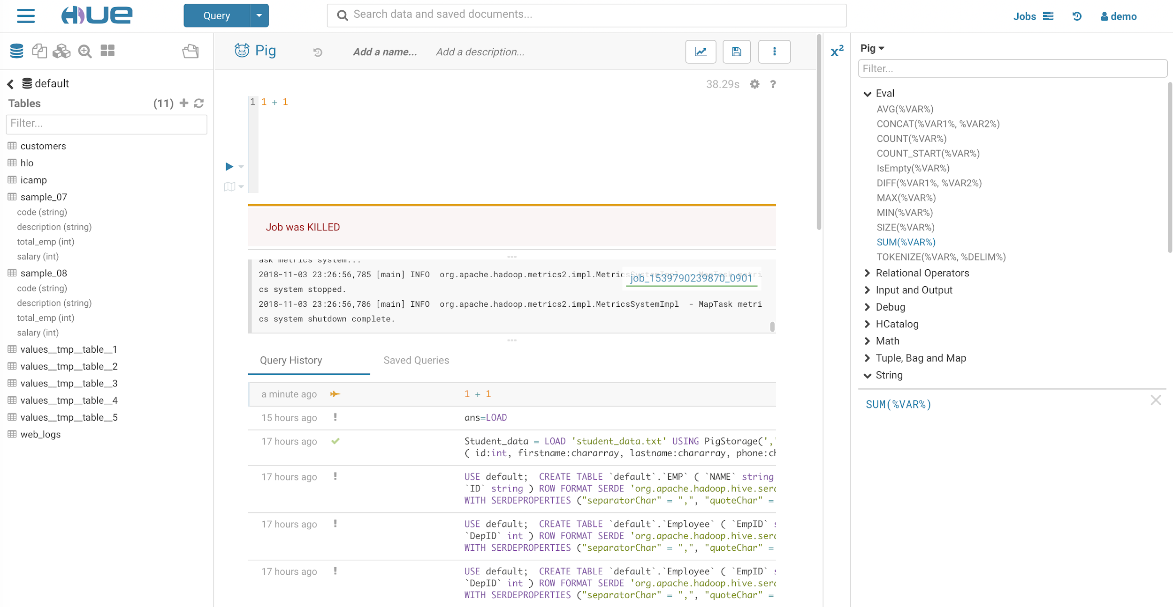
3.5 Apache and Cloudera Hadoop Distribution
Notes:
YARN = Yet Another Resource Negotiator
MapReduce 2 is more commonly use
HBase query column store abstraction on top of HDFS
HiVE = HQL -> use to query HBase
Pig = used forr ETL-Like Processes
Mahout = for machine learning or predictive analytics
Oozie = workflow or coordination of jobs
Zookeper = coordination of group of jobs
Scoop for data exchange in between other systems particulary relational systems like SQL server and Hadoop
Flume = log collector since Hadoop jobs produce a large amount of log information about job process because jobs are running batch so it’ll takes time to run
Ambari=Provisioning, Managing, and Monitoring Hadoop Clusters

Slide 41
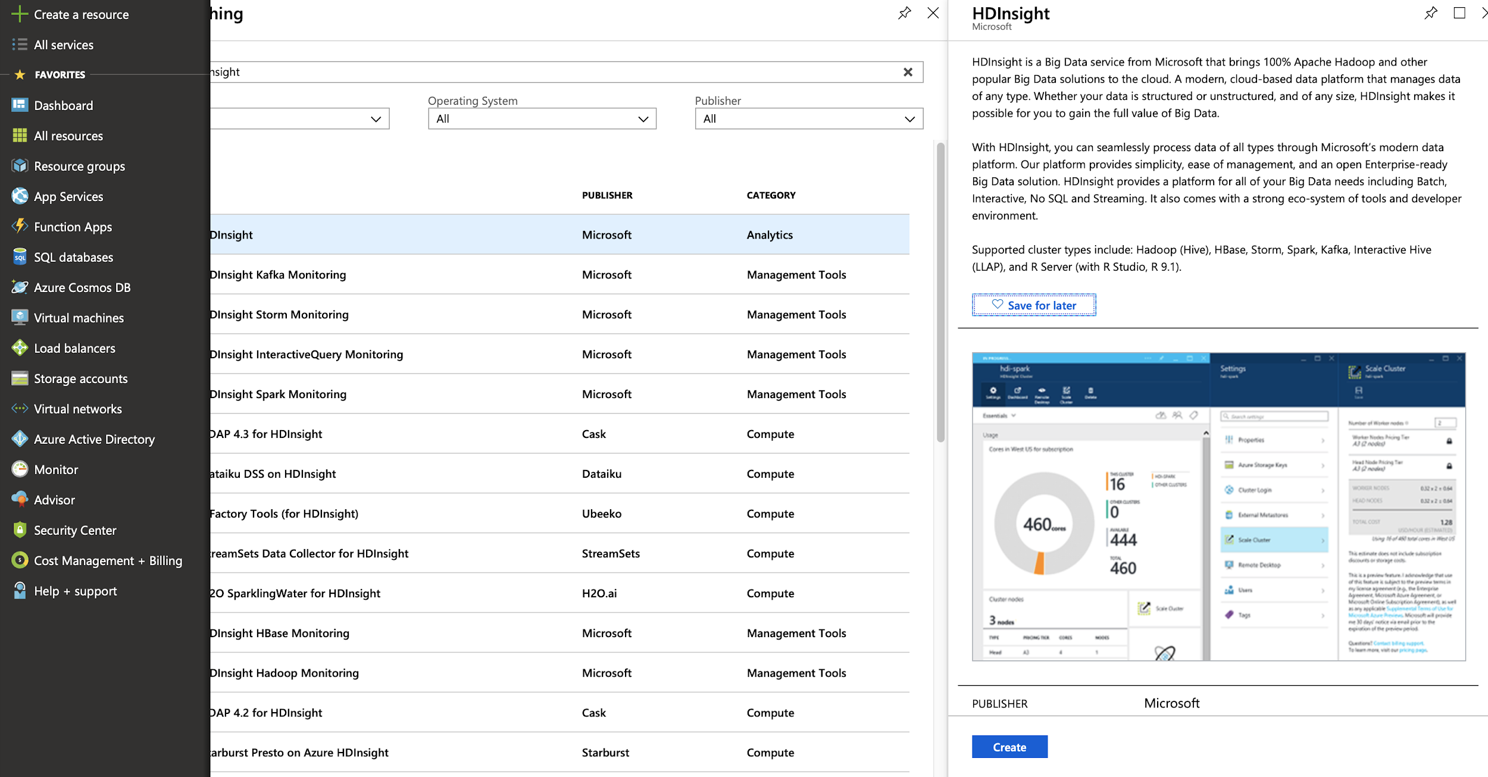
3.6 Try Microsoft Azure HDInsight
Notes:
YARN = Yet Another Resource Negotiator
MapReduce 2 is more commonly use
HBase query column store abstraction on top of HDFS
HiVE = HQL -> use to query HBase
Pig = used forr ETL-Like Processes
Mahout = for machine learning or predictive analytics
Oozie = workflow or coordination of jobs
Zookeper = coordination of group of jobs
Scoop for data exchange in between other systems particulary relational systems like SQL server and Hadoop
Flume = log collector since Hadoop jobs produce a large amount of log information about job process because jobs are running batch so it’ll takes time to run
Ambari=Provisioning, Managing, and Monitoring Hadoop Clusters

Slide 42
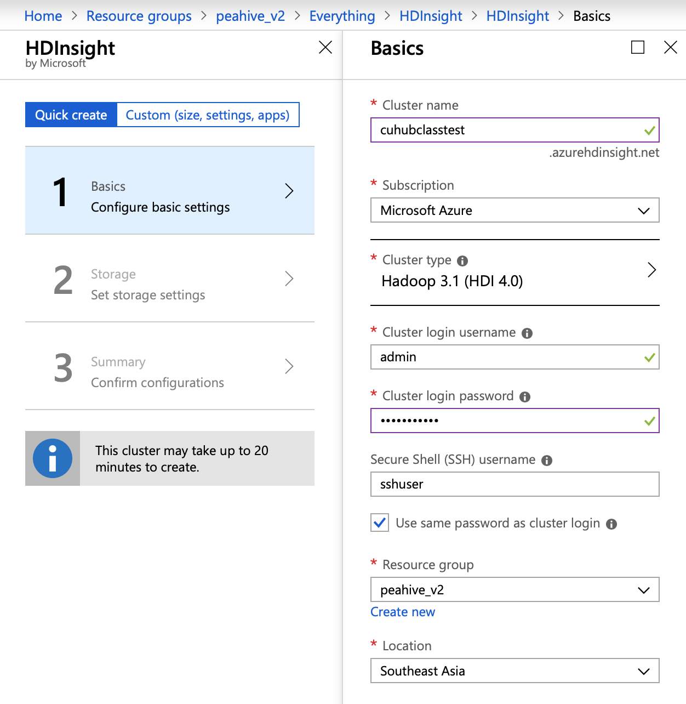
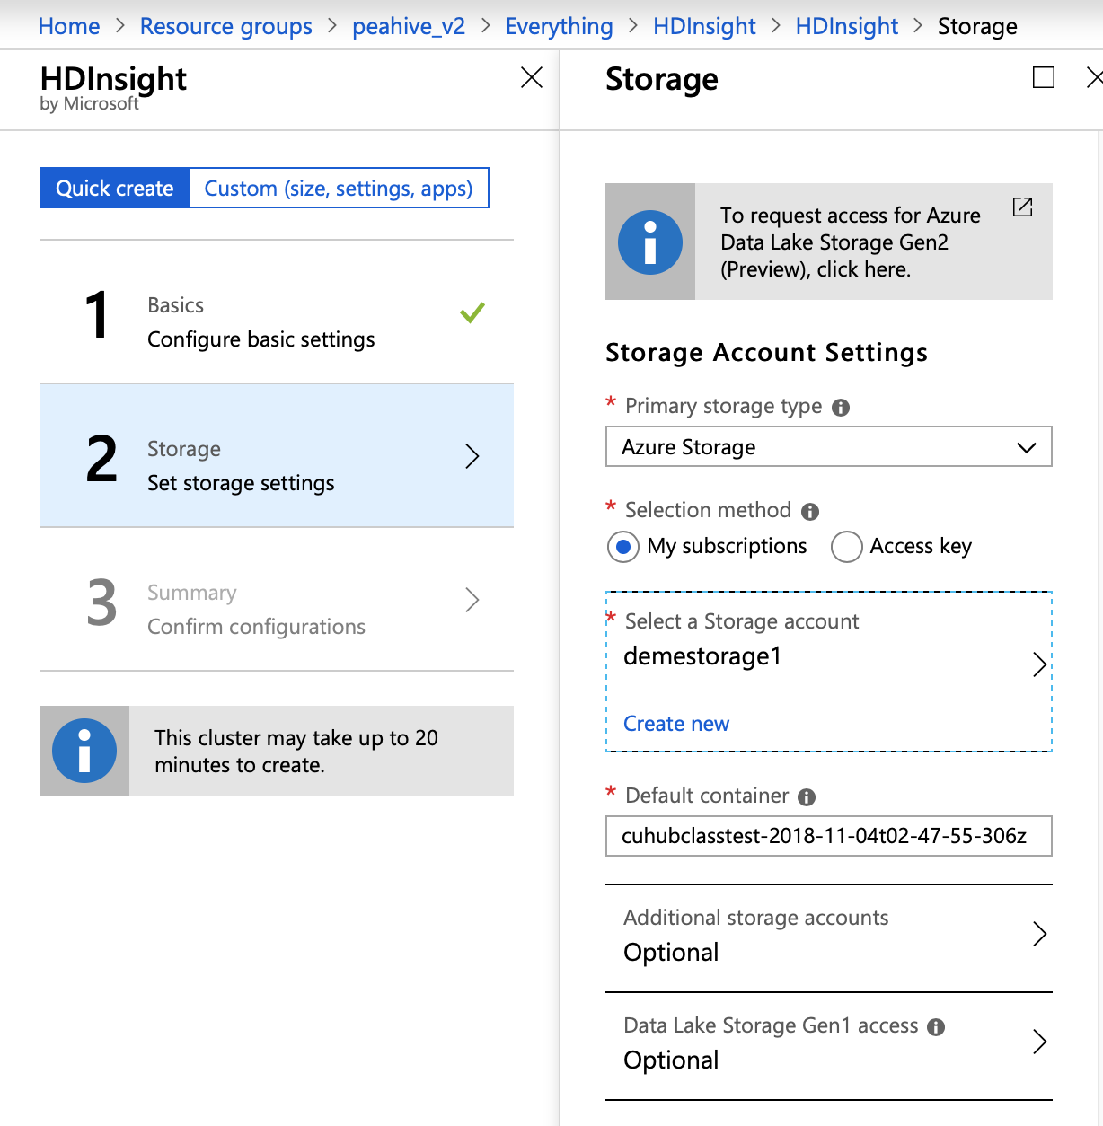
3.6 Try Microsoft Azure HDInsight
Notes:
YARN = Yet Another Resource Negotiator
MapReduce 2 is more commonly use
HBase query column store abstraction on top of HDFS
HiVE = HQL -> use to query HBase
Pig = used forr ETL-Like Processes
Mahout = for machine learning or predictive analytics
Oozie = workflow or coordination of jobs
Zookeper = coordination of group of jobs
Scoop for data exchange in between other systems particulary relational systems like SQL server and Hadoop
Flume = log collector since Hadoop jobs produce a large amount of log information about job process because jobs are running batch so it’ll takes time to run
Ambari=Provisioning, Managing, and Monitoring Hadoop Clusters

Slide 43
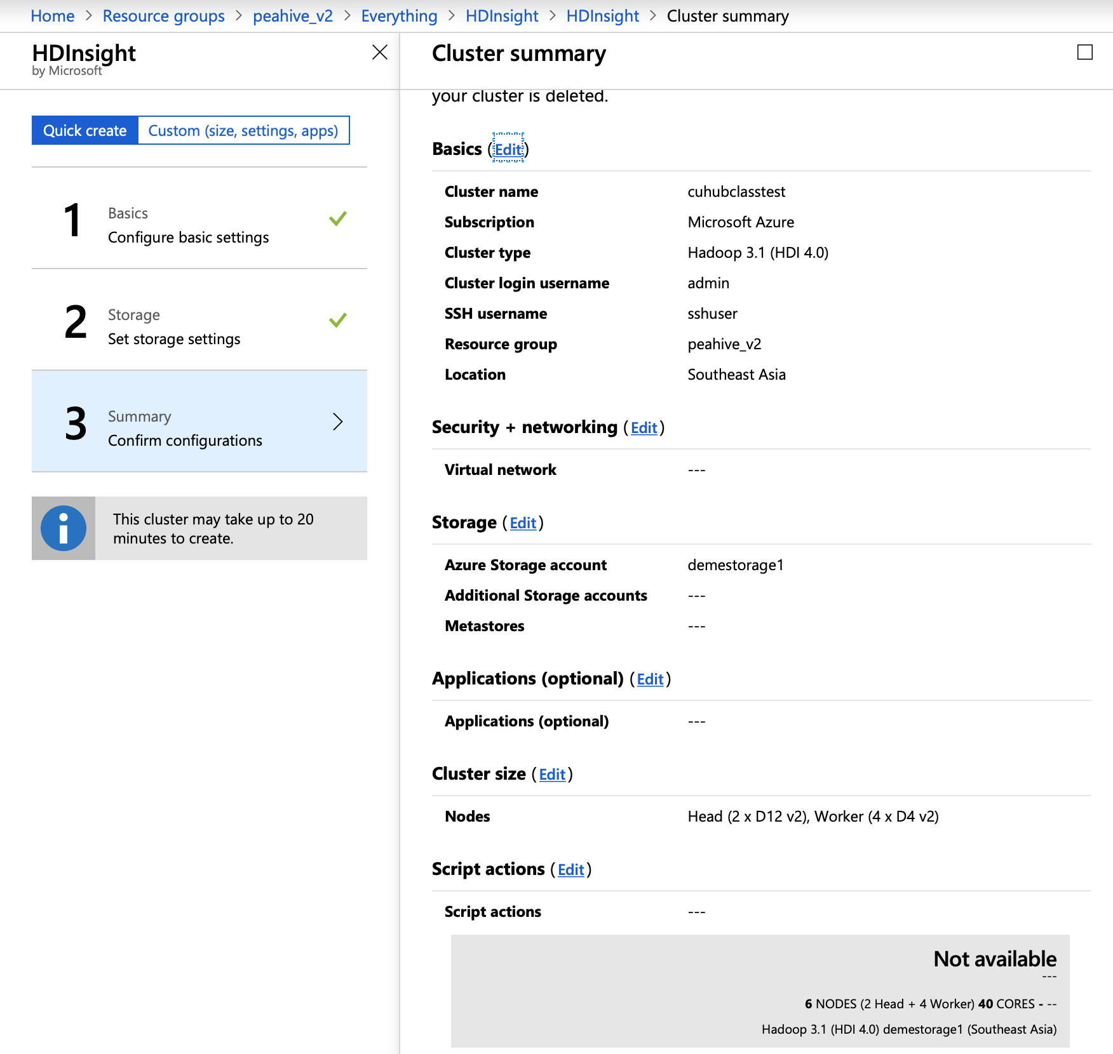
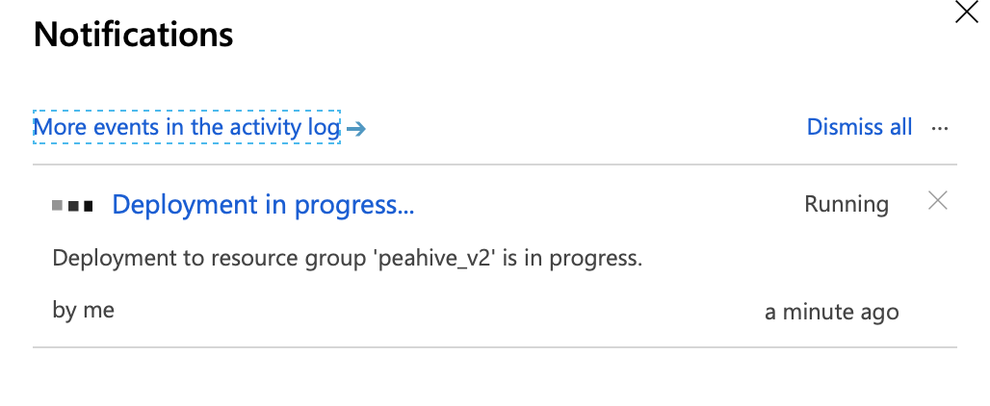
3.6 Try Microsoft Azure HDInsight
Notes:
YARN = Yet Another Resource Negotiator
MapReduce 2 is more commonly use
HBase query column store abstraction on top of HDFS
HiVE = HQL -> use to query HBase
Pig = used forr ETL-Like Processes
Mahout = for machine learning or predictive analytics
Oozie = workflow or coordination of jobs
Zookeper = coordination of group of jobs
Scoop for data exchange in between other systems particulary relational systems like SQL server and Hadoop
Flume = log collector since Hadoop jobs produce a large amount of log information about job process because jobs are running batch so it’ll takes time to run
Ambari=Provisioning, Managing, and Monitoring Hadoop Clusters

Slide 44
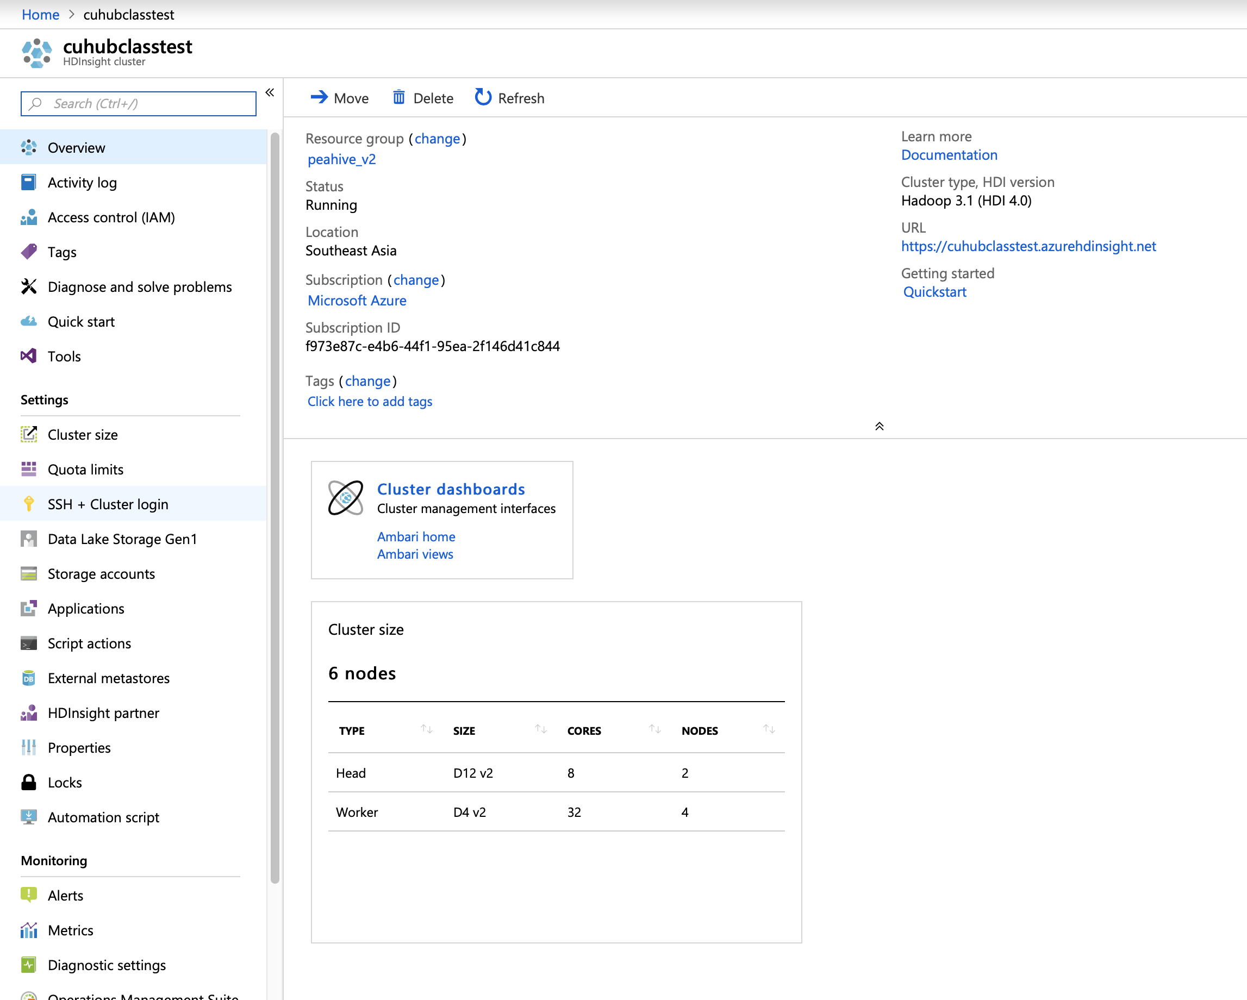
3.6 Try Microsoft Azure HDInsight
Notes:
YARN = Yet Another Resource Negotiator
MapReduce 2 is more commonly use
HBase query column store abstraction on top of HDFS
HiVE = HQL -> use to query HBase
Pig = used forr ETL-Like Processes
Mahout = for machine learning or predictive analytics
Oozie = workflow or coordination of jobs
Zookeper = coordination of group of jobs
Scoop for data exchange in between other systems particulary relational systems like SQL server and Hadoop
Flume = log collector since Hadoop jobs produce a large amount of log information about job process because jobs are running batch so it’ll takes time to run
Ambari=Provisioning, Managing, and Monitoring Hadoop Clusters

Slide 45
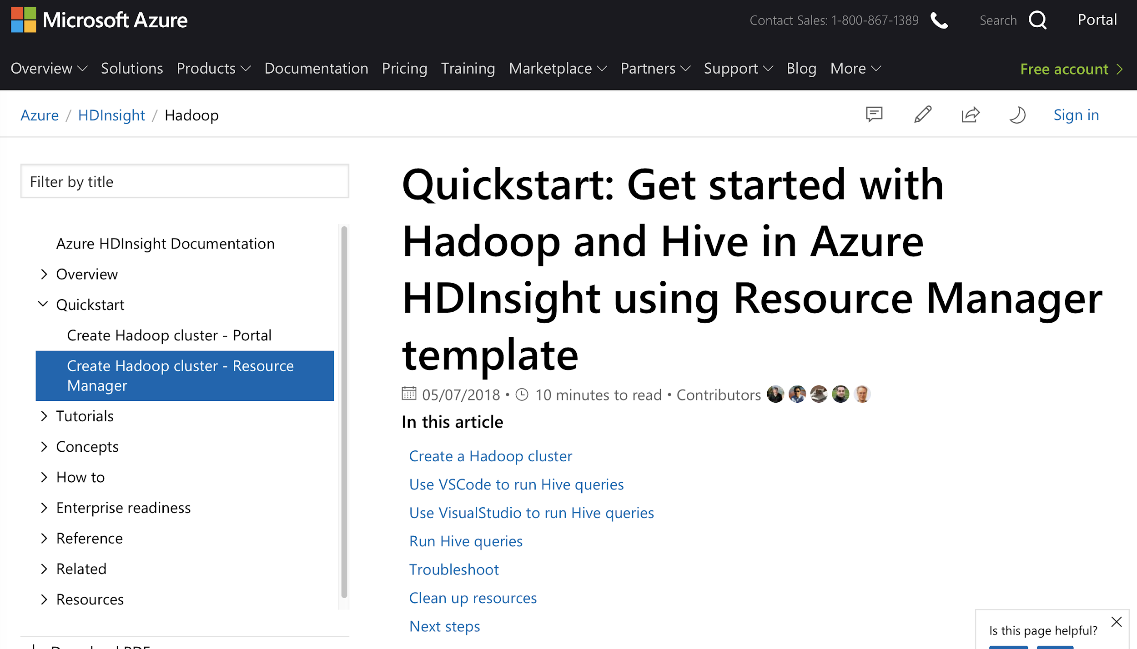
3.6 Try Microsoft Azure HDInsight
Notes:
YARN = Yet Another Resource Negotiator
MapReduce 2 is more commonly use
HBase query column store abstraction on top of HDFS
HiVE = HQL -> use to query HBase
Pig = used forr ETL-Like Processes
Mahout = for machine learning or predictive analytics
Oozie = workflow or coordination of jobs
Zookeper = coordination of group of jobs
Scoop for data exchange in between other systems particulary relational systems like SQL server and Hadoop
Flume = log collector since Hadoop jobs produce a large amount of log information about job process because jobs are running batch so it’ll takes time to run
Ambari=Provisioning, Managing, and Monitoring Hadoop Clusters

Slide 46
4. Understand HiVE

Slide 47
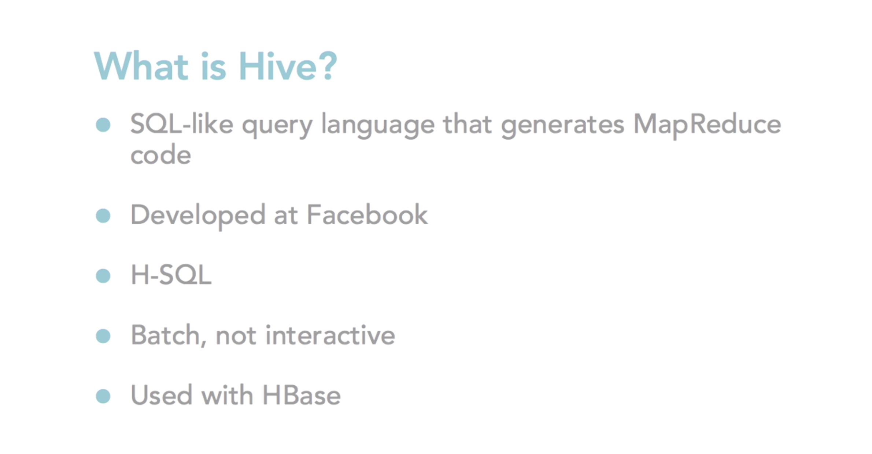
4.1 Introducing HiVE and HBase
Notes:
YARN = Yet Another Resource Negotiator
MapReduce 2 is more commonly use
HBase query column store abstraction on top of HDFS
HiVE = HQL -> use to query HBase
Pig = used forr ETL-Like Processes
Mahout = for machine learning or predictive analytics
Oozie = workflow or coordination of jobs
Zookeper = coordination of group of jobs
Scoop for data exchange in between other systems particulary relational systems like SQL server and Hadoop
Flume = log collector since Hadoop jobs produce a large amount of log information about job process because jobs are running batch so it’ll takes time to run
Ambari=Provisioning, Managing, and Monitoring Hadoop Clusters

Slide 48
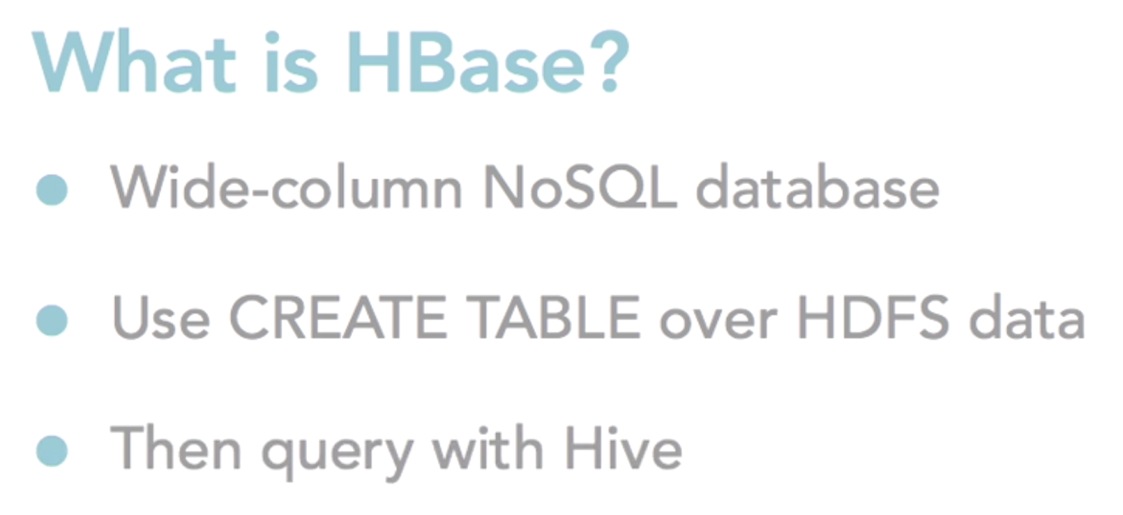
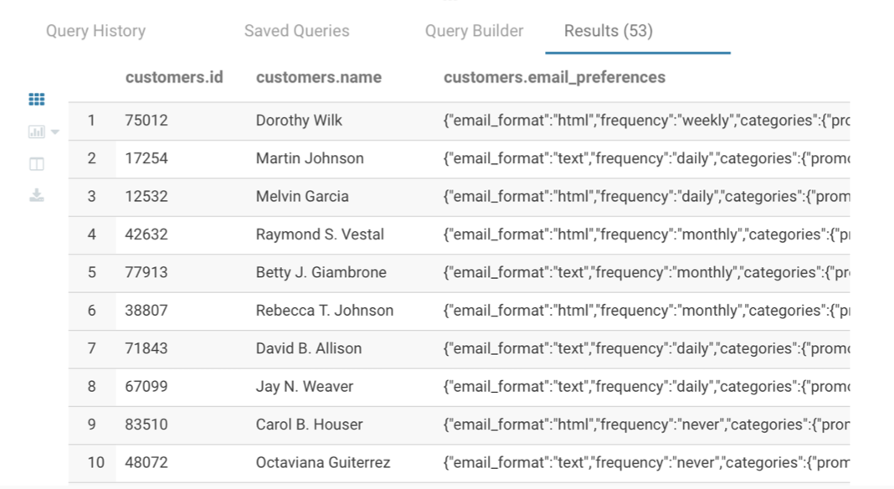
4.1 Introducing HiVE and HBase
Notes:
YARN = Yet Another Resource Negotiator
MapReduce 2 is more commonly use
HBase query column store abstraction on top of HDFS
HiVE = HQL -> use to query HBase
Pig = used forr ETL-Like Processes
Mahout = for machine learning or predictive analytics
Oozie = workflow or coordination of jobs
Zookeper = coordination of group of jobs
Scoop for data exchange in between other systems particulary relational systems like SQL server and Hadoop
Flume = log collector since Hadoop jobs produce a large amount of log information about job process because jobs are running batch so it’ll takes time to run
Ambari=Provisioning, Managing, and Monitoring Hadoop Clusters

Slide 49

4.1 Introducing HiVE and HBase
Notes:
YARN = Yet Another Resource Negotiator
MapReduce 2 is more commonly use
HBase query column store abstraction on top of HDFS
HiVE = HQL -> use to query HBase
Pig = used forr ETL-Like Processes
Mahout = for machine learning or predictive analytics
Oozie = workflow or coordination of jobs
Zookeper = coordination of group of jobs
Scoop for data exchange in between other systems particulary relational systems like SQL server and Hadoop
Flume = log collector since Hadoop jobs produce a large amount of log information about job process because jobs are running batch so it’ll takes time to run
Ambari=Provisioning, Managing, and Monitoring Hadoop Clusters

Slide 50


4.2 Understanding HiVE
Return or query can take minutes or hours depending on MapReduce Jobs
There are newer libraries that return query faster - Impala for Cloudera
Define schema on read
Notes:
YARN = Yet Another Resource Negotiator
MapReduce 2 is more commonly use
HBase query column store abstraction on top of HDFS
HiVE = HQL -> use to query HBase
Pig = used forr ETL-Like Processes
Mahout = for machine learning or predictive analytics
Oozie = workflow or coordination of jobs
Zookeper = coordination of group of jobs
Scoop for data exchange in between other systems particulary relational systems like SQL server and Hadoop
Flume = log collector since Hadoop jobs produce a large amount of log information about job process because jobs are running batch so it’ll takes time to run
Ambari=Provisioning, Managing, and Monitoring Hadoop Clusters

Slide 51

4.2 Understanding HiVE
Notes:
YARN = Yet Another Resource Negotiator
MapReduce 2 is more commonly use
HBase query column store abstraction on top of HDFS
HiVE = HQL -> use to query HBase
Pig = used forr ETL-Like Processes
Mahout = for machine learning or predictive analytics
Oozie = workflow or coordination of jobs
Zookeper = coordination of group of jobs
Scoop for data exchange in between other systems particulary relational systems like SQL server and Hadoop
Flume = log collector since Hadoop jobs produce a large amount of log information about job process because jobs are running batch so it’ll takes time to run
Ambari=Provisioning, Managing, and Monitoring Hadoop Clusters

Slide 52

4.2 Understanding HiVE
Notes:
YARN = Yet Another Resource Negotiator
MapReduce 2 is more commonly use
HBase query column store abstraction on top of HDFS
HiVE = HQL -> use to query HBase
Pig = used forr ETL-Like Processes
Mahout = for machine learning or predictive analytics
Oozie = workflow or coordination of jobs
Zookeper = coordination of group of jobs
Scoop for data exchange in between other systems particulary relational systems like SQL server and Hadoop
Flume = log collector since Hadoop jobs produce a large amount of log information about job process because jobs are running batch so it’ll takes time to run
Ambari=Provisioning, Managing, and Monitoring Hadoop Clusters

Slide 53

4.2 Understanding HiVE
Not Good for Data Cleaning, ETL, ..
Need interactive with HDFS go for Impala for Cloudera
Notes:
YARN = Yet Another Resource Negotiator
MapReduce 2 is more commonly use
HBase query column store abstraction on top of HDFS
HiVE = HQL -> use to query HBase
Pig = used forr ETL-Like Processes
Mahout = for machine learning or predictive analytics
Oozie = workflow or coordination of jobs
Zookeper = coordination of group of jobs
Scoop for data exchange in between other systems particulary relational systems like SQL server and Hadoop
Flume = log collector since Hadoop jobs produce a large amount of log information about job process because jobs are running batch so it’ll takes time to run
Ambari=Provisioning, Managing, and Monitoring Hadoop Clusters

Slide 54


4.3 Example Word Count using HiVE
Somewhat not to easy to do regex with HQL, we’d rather use Pig, then use HiVE to get data from HBase
Notes:
YARN = Yet Another Resource Negotiator
MapReduce 2 is more commonly use
HBase query column store abstraction on top of HDFS
HiVE = HQL -> use to query HBase
Pig = used forr ETL-Like Processes
Mahout = for machine learning or predictive analytics
Oozie = workflow or coordination of jobs
Zookeper = coordination of group of jobs
Scoop for data exchange in between other systems particulary relational systems like SQL server and Hadoop
Flume = log collector since Hadoop jobs produce a large amount of log information about job process because jobs are running batch so it’ll takes time to run
Ambari=Provisioning, Managing, and Monitoring Hadoop Clusters

Slide 55


4.4 HQL Query Optimization
Notes:
YARN = Yet Another Resource Negotiator
MapReduce 2 is more commonly use
HBase query column store abstraction on top of HDFS
HiVE = HQL -> use to query HBase
Pig = used forr ETL-Like Processes
Mahout = for machine learning or predictive analytics
Oozie = workflow or coordination of jobs
Zookeper = coordination of group of jobs
Scoop for data exchange in between other systems particulary relational systems like SQL server and Hadoop
Flume = log collector since Hadoop jobs produce a large amount of log information about job process because jobs are running batch so it’ll takes time to run
Ambari=Provisioning, Managing, and Monitoring Hadoop Clusters

Slide 56

4.5 HiVE tools in Cloudera Distribution and Hue Web Console
Notes:
YARN = Yet Another Resource Negotiator
MapReduce 2 is more commonly use
HBase query column store abstraction on top of HDFS
HiVE = HQL -> use to query HBase
Pig = used forr ETL-Like Processes
Mahout = for machine learning or predictive analytics
Oozie = workflow or coordination of jobs
Zookeper = coordination of group of jobs
Scoop for data exchange in between other systems particulary relational systems like SQL server and Hadoop
Flume = log collector since Hadoop jobs produce a large amount of log information about job process because jobs are running batch so it’ll takes time to run
Ambari=Provisioning, Managing, and Monitoring Hadoop Clusters

Slide 57

4.5 HiVE tools in Cloudera Distribution and Hue Web Console
Notes:
YARN = Yet Another Resource Negotiator
MapReduce 2 is more commonly use
HBase query column store abstraction on top of HDFS
HiVE = HQL -> use to query HBase
Pig = used forr ETL-Like Processes
Mahout = for machine learning or predictive analytics
Oozie = workflow or coordination of jobs
Zookeper = coordination of group of jobs
Scoop for data exchange in between other systems particulary relational systems like SQL server and Hadoop
Flume = log collector since Hadoop jobs produce a large amount of log information about job process because jobs are running batch so it’ll takes time to run
Ambari=Provisioning, Managing, and Monitoring Hadoop Clusters

Slide 58

4.5 HiVE tools in Cloudera Distribution and Hue Web Console
Click to see in Metastore Browser
Notes:
YARN = Yet Another Resource Negotiator
MapReduce 2 is more commonly use
HBase query column store abstraction on top of HDFS
HiVE = HQL -> use to query HBase
Pig = used forr ETL-Like Processes
Mahout = for machine learning or predictive analytics
Oozie = workflow or coordination of jobs
Zookeper = coordination of group of jobs
Scoop for data exchange in between other systems particulary relational systems like SQL server and Hadoop
Flume = log collector since Hadoop jobs produce a large amount of log information about job process because jobs are running batch so it’ll takes time to run
Ambari=Provisioning, Managing, and Monitoring Hadoop Clusters

Slide 59

4.5 HiVE tools in Cloudera Distribution and Hue Web Console
Notes:
YARN = Yet Another Resource Negotiator
MapReduce 2 is more commonly use
HBase query column store abstraction on top of HDFS
HiVE = HQL -> use to query HBase
Pig = used forr ETL-Like Processes
Mahout = for machine learning or predictive analytics
Oozie = workflow or coordination of jobs
Zookeper = coordination of group of jobs
Scoop for data exchange in between other systems particulary relational systems like SQL server and Hadoop
Flume = log collector since Hadoop jobs produce a large amount of log information about job process because jobs are running batch so it’ll takes time to run
Ambari=Provisioning, Managing, and Monitoring Hadoop Clusters

Slide 60


4.5 HiVE tools in Cloudera Distribution and Hue Web Console
You can import new data
Notes:
YARN = Yet Another Resource Negotiator
MapReduce 2 is more commonly use
HBase query column store abstraction on top of HDFS
HiVE = HQL -> use to query HBase
Pig = used forr ETL-Like Processes
Mahout = for machine learning or predictive analytics
Oozie = workflow or coordination of jobs
Zookeper = coordination of group of jobs
Scoop for data exchange in between other systems particulary relational systems like SQL server and Hadoop
Flume = log collector since Hadoop jobs produce a large amount of log information about job process because jobs are running batch so it’ll takes time to run
Ambari=Provisioning, Managing, and Monitoring Hadoop Clusters

Slide 61

4.5 HiVE tools in Cloudera Distribution and Hue Web Console
Let’s try query Top Salary
Notes:
YARN = Yet Another Resource Negotiator
MapReduce 2 is more commonly use
HBase query column store abstraction on top of HDFS
HiVE = HQL -> use to query HBase
Pig = used forr ETL-Like Processes
Mahout = for machine learning or predictive analytics
Oozie = workflow or coordination of jobs
Zookeper = coordination of group of jobs
Scoop for data exchange in between other systems particulary relational systems like SQL server and Hadoop
Flume = log collector since Hadoop jobs produce a large amount of log information about job process because jobs are running batch so it’ll takes time to run
Ambari=Provisioning, Managing, and Monitoring Hadoop Clusters

Slide 62

4.5 HiVE tools in Cloudera Distribution and Hue Web Console
Let’s try query Job Loss
Notes:
YARN = Yet Another Resource Negotiator
MapReduce 2 is more commonly use
HBase query column store abstraction on top of HDFS
HiVE = HQL -> use to query HBase
Pig = used forr ETL-Like Processes
Mahout = for machine learning or predictive analytics
Oozie = workflow or coordination of jobs
Zookeper = coordination of group of jobs
Scoop for data exchange in between other systems particulary relational systems like SQL server and Hadoop
Flume = log collector since Hadoop jobs produce a large amount of log information about job process because jobs are running batch so it’ll takes time to run
Ambari=Provisioning, Managing, and Monitoring Hadoop Clusters

Slide 63
5. Understand Pig

Slide 64

5.1 Understand Pig
Notes:
YARN = Yet Another Resource Negotiator
MapReduce 2 is more commonly use
HBase query column store abstraction on top of HDFS
HiVE = HQL -> use to query HBase
Pig = used forr ETL-Like Processes
Mahout = for machine learning or predictive analytics
Oozie = workflow or coordination of jobs
Zookeper = coordination of group of jobs
Scoop for data exchange in between other systems particulary relational systems like SQL server and Hadoop
Flume = log collector since Hadoop jobs produce a large amount of log information about job process because jobs are running batch so it’ll takes time to run
Ambari=Provisioning, Managing, and Monitoring Hadoop Clusters

Slide 65

5.1 Understand Pig
Notes:
YARN = Yet Another Resource Negotiator
MapReduce 2 is more commonly use
HBase query column store abstraction on top of HDFS
HiVE = HQL -> use to query HBase
Pig = used forr ETL-Like Processes
Mahout = for machine learning or predictive analytics
Oozie = workflow or coordination of jobs
Zookeper = coordination of group of jobs
Scoop for data exchange in between other systems particulary relational systems like SQL server and Hadoop
Flume = log collector since Hadoop jobs produce a large amount of log information about job process because jobs are running batch so it’ll takes time to run
Ambari=Provisioning, Managing, and Monitoring Hadoop Clusters

Slide 66

5.1 Understand Pig
Notes:
YARN = Yet Another Resource Negotiator
MapReduce 2 is more commonly use
HBase query column store abstraction on top of HDFS
HiVE = HQL -> use to query HBase
Pig = used forr ETL-Like Processes
Mahout = for machine learning or predictive analytics
Oozie = workflow or coordination of jobs
Zookeper = coordination of group of jobs
Scoop for data exchange in between other systems particulary relational systems like SQL server and Hadoop
Flume = log collector since Hadoop jobs produce a large amount of log information about job process because jobs are running batch so it’ll takes time to run
Ambari=Provisioning, Managing, and Monitoring Hadoop Clusters

Slide 67

5.1 Understand Pig
Notes:
YARN = Yet Another Resource Negotiator
MapReduce 2 is more commonly use
HBase query column store abstraction on top of HDFS
HiVE = HQL -> use to query HBase
Pig = used forr ETL-Like Processes
Mahout = for machine learning or predictive analytics
Oozie = workflow or coordination of jobs
Zookeper = coordination of group of jobs
Scoop for data exchange in between other systems particulary relational systems like SQL server and Hadoop
Flume = log collector since Hadoop jobs produce a large amount of log information about job process because jobs are running batch so it’ll takes time to run
Ambari=Provisioning, Managing, and Monitoring Hadoop Clusters

Slide 68

5.1 Understand Pig
Notes:
YARN = Yet Another Resource Negotiator
MapReduce 2 is more commonly use
HBase query column store abstraction on top of HDFS
HiVE = HQL -> use to query HBase
Pig = used forr ETL-Like Processes
Mahout = for machine learning or predictive analytics
Oozie = workflow or coordination of jobs
Zookeper = coordination of group of jobs
Scoop for data exchange in between other systems particulary relational systems like SQL server and Hadoop
Flume = log collector since Hadoop jobs produce a large amount of log information about job process because jobs are running batch so it’ll takes time to run
Ambari=Provisioning, Managing, and Monitoring Hadoop Clusters

Slide 69

5.1 Understand Pig
Notes:
YARN = Yet Another Resource Negotiator
MapReduce 2 is more commonly use
HBase query column store abstraction on top of HDFS
HiVE = HQL -> use to query HBase
Pig = used forr ETL-Like Processes
Mahout = for machine learning or predictive analytics
Oozie = workflow or coordination of jobs
Zookeper = coordination of group of jobs
Scoop for data exchange in between other systems particulary relational systems like SQL server and Hadoop
Flume = log collector since Hadoop jobs produce a large amount of log information about job process because jobs are running batch so it’ll takes time to run
Ambari=Provisioning, Managing, and Monitoring Hadoop Clusters

Slide 70

5.2 Use cases for Pig
Notes:
YARN = Yet Another Resource Negotiator
MapReduce 2 is more commonly use
HBase query column store abstraction on top of HDFS
HiVE = HQL -> use to query HBase
Pig = used forr ETL-Like Processes
Mahout = for machine learning or predictive analytics
Oozie = workflow or coordination of jobs
Zookeper = coordination of group of jobs
Scoop for data exchange in between other systems particulary relational systems like SQL server and Hadoop
Flume = log collector since Hadoop jobs produce a large amount of log information about job process because jobs are running batch so it’ll takes time to run
Ambari=Provisioning, Managing, and Monitoring Hadoop Clusters

Slide 71

5.2 Use cases for Pig
Notes:
YARN = Yet Another Resource Negotiator
MapReduce 2 is more commonly use
HBase query column store abstraction on top of HDFS
HiVE = HQL -> use to query HBase
Pig = used forr ETL-Like Processes
Mahout = for machine learning or predictive analytics
Oozie = workflow or coordination of jobs
Zookeper = coordination of group of jobs
Scoop for data exchange in between other systems particulary relational systems like SQL server and Hadoop
Flume = log collector since Hadoop jobs produce a large amount of log information about job process because jobs are running batch so it’ll takes time to run
Ambari=Provisioning, Managing, and Monitoring Hadoop Clusters

Slide 72

5.3 Exploring Pig on Cloudera
Notes:
YARN = Yet Another Resource Negotiator
MapReduce 2 is more commonly use
HBase query column store abstraction on top of HDFS
HiVE = HQL -> use to query HBase
Pig = used forr ETL-Like Processes
Mahout = for machine learning or predictive analytics
Oozie = workflow or coordination of jobs
Zookeper = coordination of group of jobs
Scoop for data exchange in between other systems particulary relational systems like SQL server and Hadoop
Flume = log collector since Hadoop jobs produce a large amount of log information about job process because jobs are running batch so it’ll takes time to run
Ambari=Provisioning, Managing, and Monitoring Hadoop Clusters

Slide 73

5.3 Exploring Pig on Cloudera
Let’s try UpperText
Run
Notes:
YARN = Yet Another Resource Negotiator
MapReduce 2 is more commonly use
HBase query column store abstraction on top of HDFS
HiVE = HQL -> use to query HBase
Pig = used forr ETL-Like Processes
Mahout = for machine learning or predictive analytics
Oozie = workflow or coordination of jobs
Zookeper = coordination of group of jobs
Scoop for data exchange in between other systems particulary relational systems like SQL server and Hadoop
Flume = log collector since Hadoop jobs produce a large amount of log information about job process because jobs are running batch so it’ll takes time to run
Ambari=Provisioning, Managing, and Monitoring Hadoop Clusters

Slide 74

5.3 Exploring Pig on Cloudera
You should see this
Notes:
YARN = Yet Another Resource Negotiator
MapReduce 2 is more commonly use
HBase query column store abstraction on top of HDFS
HiVE = HQL -> use to query HBase
Pig = used forr ETL-Like Processes
Mahout = for machine learning or predictive analytics
Oozie = workflow or coordination of jobs
Zookeper = coordination of group of jobs
Scoop for data exchange in between other systems particulary relational systems like SQL server and Hadoop
Flume = log collector since Hadoop jobs produce a large amount of log information about job process because jobs are running batch so it’ll takes time to run
Ambari=Provisioning, Managing, and Monitoring Hadoop Clusters

Slide 75
6 . Hadoop Workflow and Connectors

